Slide 1







CICABO Étude de la résistance génétique au virus des pieds chétifs chez l’orge et le blé tendre d’hiver
Britta Buckwied (JKi)
Torsten Will (JKi)
Alexis Oger (Syngenta, porteur de projet)
Chami Berger (Syngenta, porteur de projet)

Slide 2
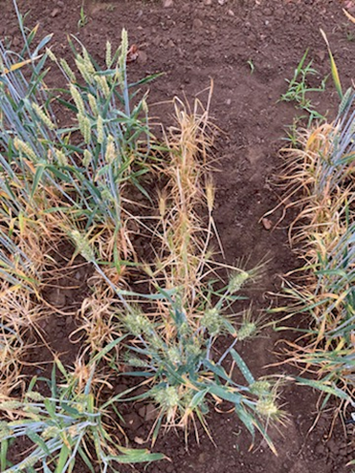
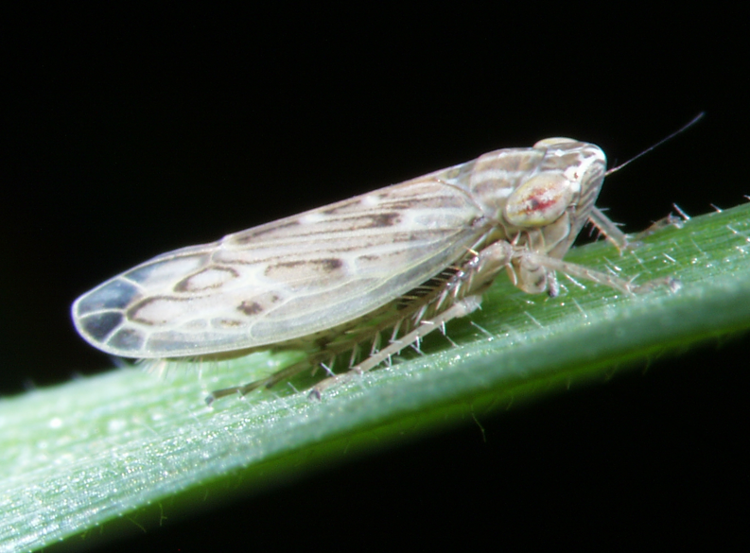
Introduction
Wheat Dwarf Virus (WDV)
Emerging viral disease of bread wheat (Triticum aestivum L.)
Vector: Psammotettix alienus
Symptoms: dwarfing, yellowing, tillering reduction, yield losses up to 80%
Disease management
Agronomic: delayed sowing, crop rotation, weed management...
Insecticide (insect monitoring)
Genetic control: tolerant varieties (Fisht), QTL on chromosome 6A
WDV symptoms
Psammotettix alienus

Slide 3
Project objectives
Phenotype a diversity panel under natural and controlled conditions
Identify resistance/tolerance QTLs through GWAS
Validate regions of interest in biparental populations
Identification of the resistance target through vector behavioural analysis

Slide 4
Plant Material - WDVWP Panel
Panel Composition (Wheat Dwarf Virus Wheat Panel)
Breedwheat diversity Panel (WP3) – INRAE CRB Clermont Ferrand
Introgression lines with related wild species (A. muticum and T. urartu) – King / University of Nottingham
Synthetic wheat derivatives – NIAB
Checks (incl. Fisht as resistant control)
Panel Evolution
2021-2024: 247 to 83 accessions based on seed availability and disease resistance levels after phenotyping

Slide 5
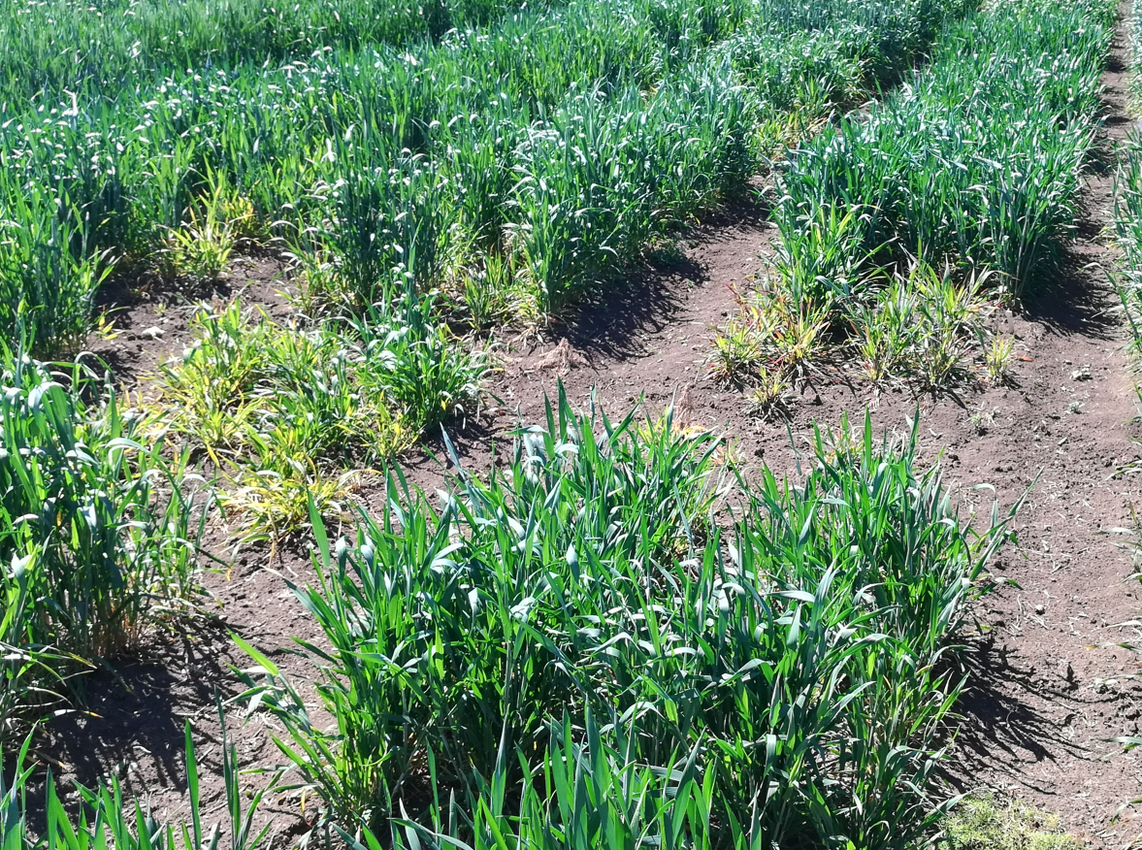
Phenotyping protocol
Evaluation Sites
3 sites in France + 1 site in Czech Republic x 4 years
Experimental Design
Micro-plots: 5 rows, ~1.5 m²
Randomized complete blocks, 3 replications
Early sowing: September
Pest Monitoring:
Chromatic traps during autumn (weekly) => ELISA test
Plant sampling (March and April) => ELISA test
Scoring:
Scale 1-9
Field trial

Slide 6
Genotyping and GWAS Analysis
Genotyping
Illumina Infinium 25K chip (TraitGenetics)
GWAS Analysis
Model: EMMA (Efficient Mixed Model Association)
Statistical correction: Bonferroni (p < 0.1)
Reference map: Chinese Spring v2.1

Slide 7
Phenotyping results (2021-2024)
Out of 16 site × year combinations
2 sites used for analysis
High pressure : Czech Republic, 2022
Medium pressure with strong co-infection with BYDV: France, 2024
Major Challenges
Low density of viruliferous leafhoppers
Systematic WDV/BYDV co-infection with predominance of BYDV

Slide 8
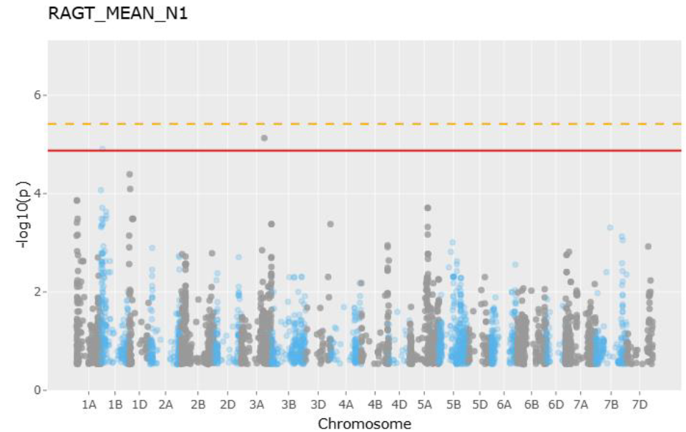
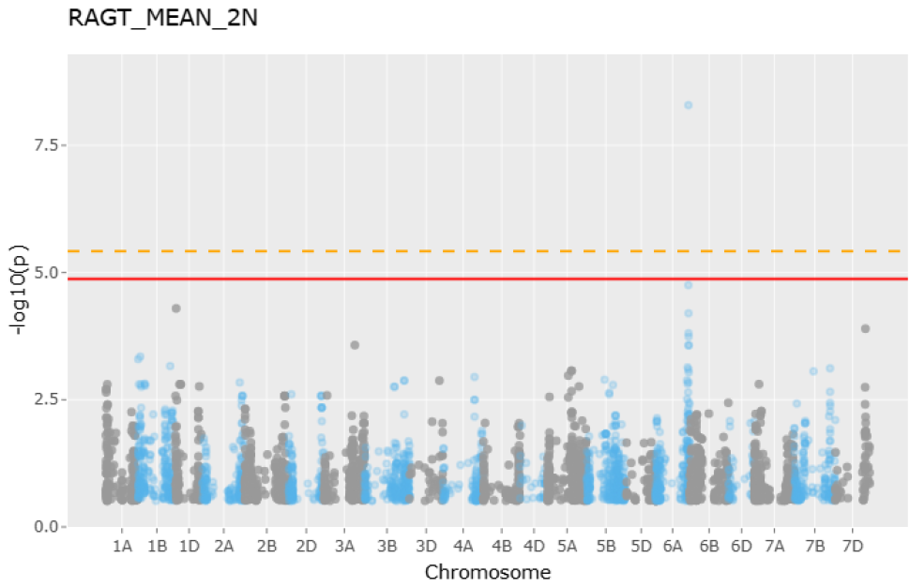
GWAS Results
Major QTL:
Chr 6A - 3 markers - 599-602 Mbp, R2 = 0,12 to 0,2
=> Confirm results from Pfrieme et al. (2022)
Minor QTLs:
Chr 1B - 1 marker - 394 Mbp, R2 = 0,1
Chr 3A - 1 marker - 567 Mbp, R2 = 0,05

Slide 9
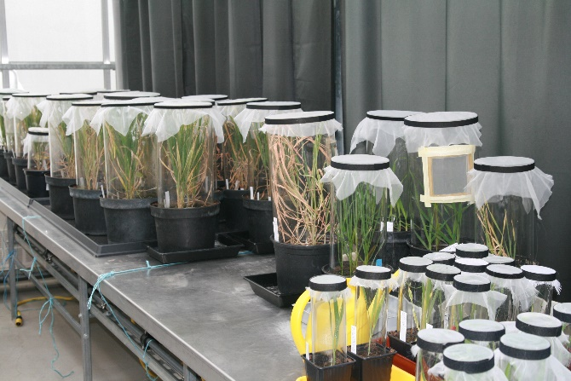
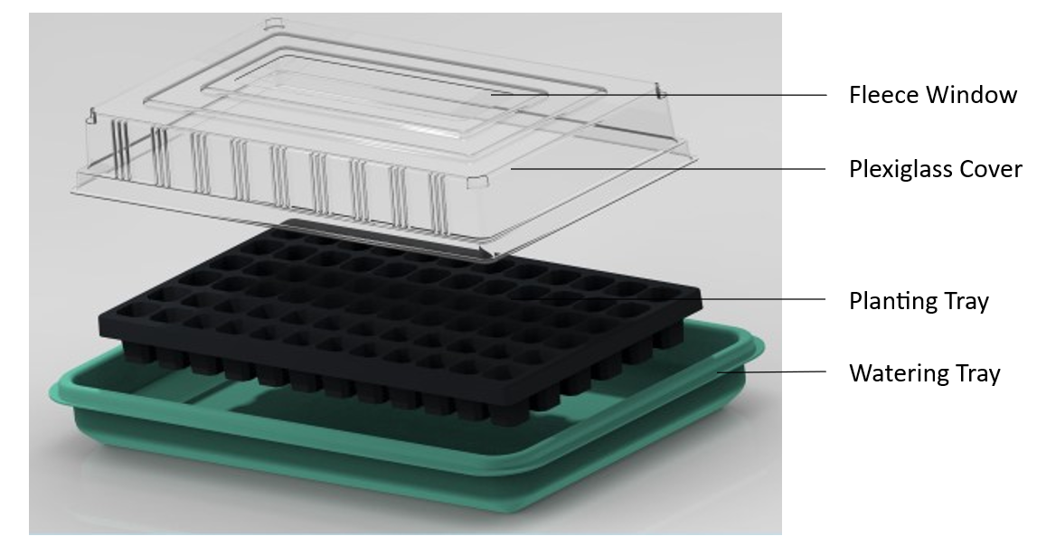
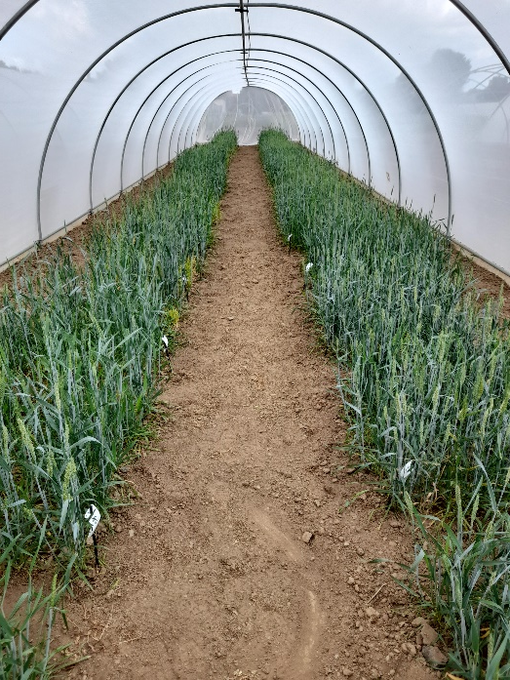
WDV trials under controlled conditions
Method
Vector-mediated inoculation with Psammotettix alienus
Greenhouse screening
243 genotypes (identical to field trials)
Randomized, 3 replicates, 10 plants per replicate
Gauze tent screening
90 selected genotypes
Randomized, 3 replicates, infected vs.
control variant per genotype
Identification of WDV-resistant and
tolerant genotypes with
stable agronomic performance
Infection hood (Pfrieme et al. 2024)

Slide 10
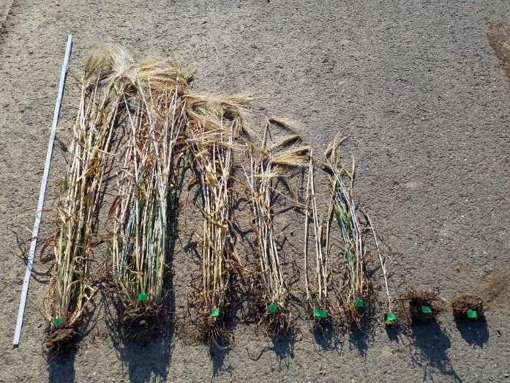
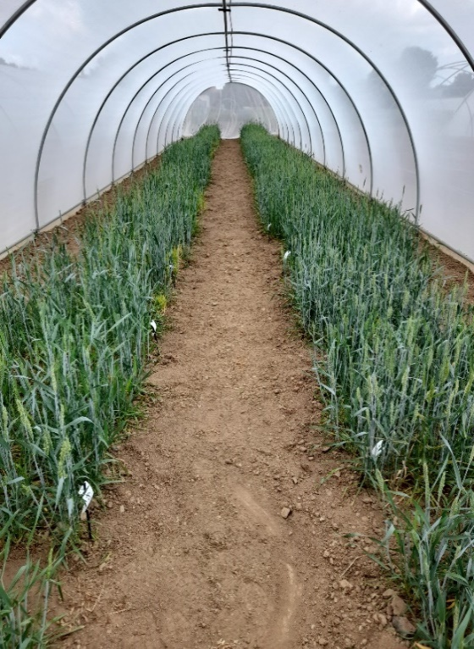
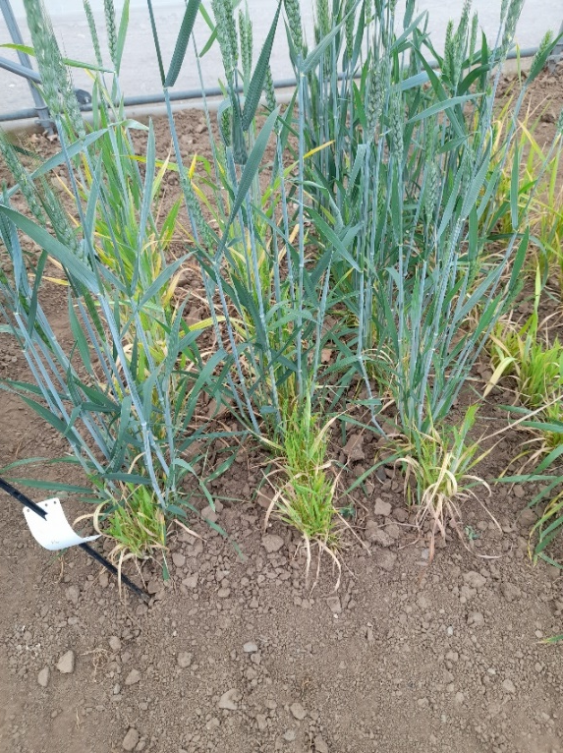
WDV trials under controlled conditions
Phenotyping
WDV symptoms: score 1–9
WDV load: DAS-ELISA (titer, infection rate)
90 genotypes
Tolerance traits: height, yield, ears/plant, TKW
Genotyping & GWAS
Panels: 243G & 90G; 25K iSelect SNPs
SNP filters: MAF ≥ 5%, missing ≤10%, het ≤12.5%
GWAS: CMLM & farmCPU (GAPIT)
Significance: Bonferroni (LD-pruned, p<0.05)
QTL: LD decay r²=0.20; genes ±1.8 Mb (IWGSC v2.1)

Slide 11
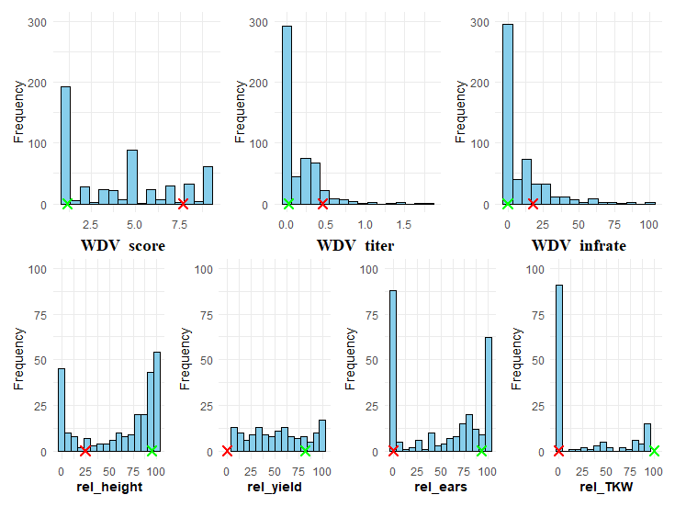
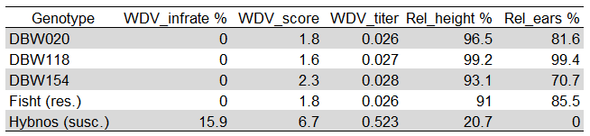
WDV trials under controlled conditions
Phenotypic variation in WDV resistance
Significant variation for WDV traits
Most genotypes susceptible
Hybnos susceptible, Fisht resistant
3 genotypes fully resistant across environments
DBW020
DBW118
DBW154
Higher trait correlations in greenhouse (r = 0.50–0.76)
vs. gauze tent (r = 0.49–0.58)
Replicate variation driven by WDV transmission efficiency
Distribution of mean WDV values per location (top) and adjusted means of identified resistant accessions (bottom), including control cvs. Fisht (R) and Hybnos (S).

Slide 12
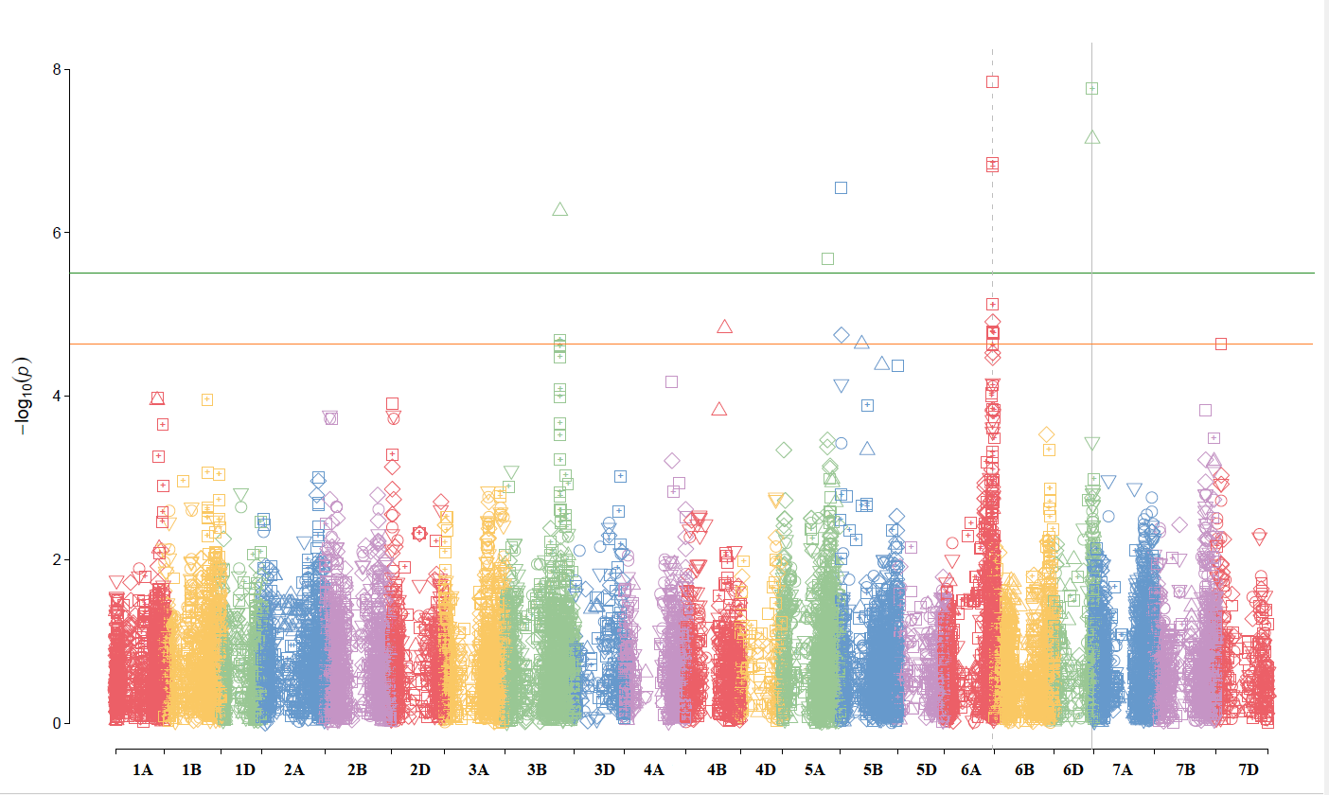
WDV trials under controlled conditions
GWAS results
16 significant MTAs on 8 chromosomes
243G: 3B, 5A, 5B, 6A, 6D
90G: 1B, 4B, 4D
Major QTL on Chr 6A (601-603 Mbp)
AX-95151036: WDV titer & infection rate confirmed in field trials; overlaps (Buerstmeyer et al. 2022)
Confirmed QTL: Chrs 1B, 3B, 4B, 5A, 6A (Pfrieme et al. 2022)
Additional QTL: 4D, 6D (6D significant in both models)
Manhattan plots (243G): WDV titer & infection rate under controlled conditions (CMLM, FarmCPU). Orange lines show adjusted (LOD 4.7) and strict (LOD 5.5) Bonferroni thresholds (p<0.05).

Slide 13
Conclusions
Key association findings
Limitations
Heterogeneous infection pressure
Only 1 exploitable nursery out of 16 site × year combinations
Low and variable viruliferous density
Captured leafhoppers not systematically carrying WDV
WDV/BYDV Co-infection
Nearly systematic presence of both viruses
Similar symptoms → phenotypic evaluation bias
Phytoplasma co-infection
Variable transmission efficiency of the WDV
QTL WDV / wheat | Field conditions | Controlled conditions
Common, overlapping major QTL | 6A (599–602 Mbp) | 6A (601–603 Mbp)
Additional QTL identified in regions with described minor QTL | 1B, 3A | 1B, 3B, 4B, 4D, 5A, 5B, 6A, 6D
Putative novel QTL |  | 4D, 6D

Slide 14
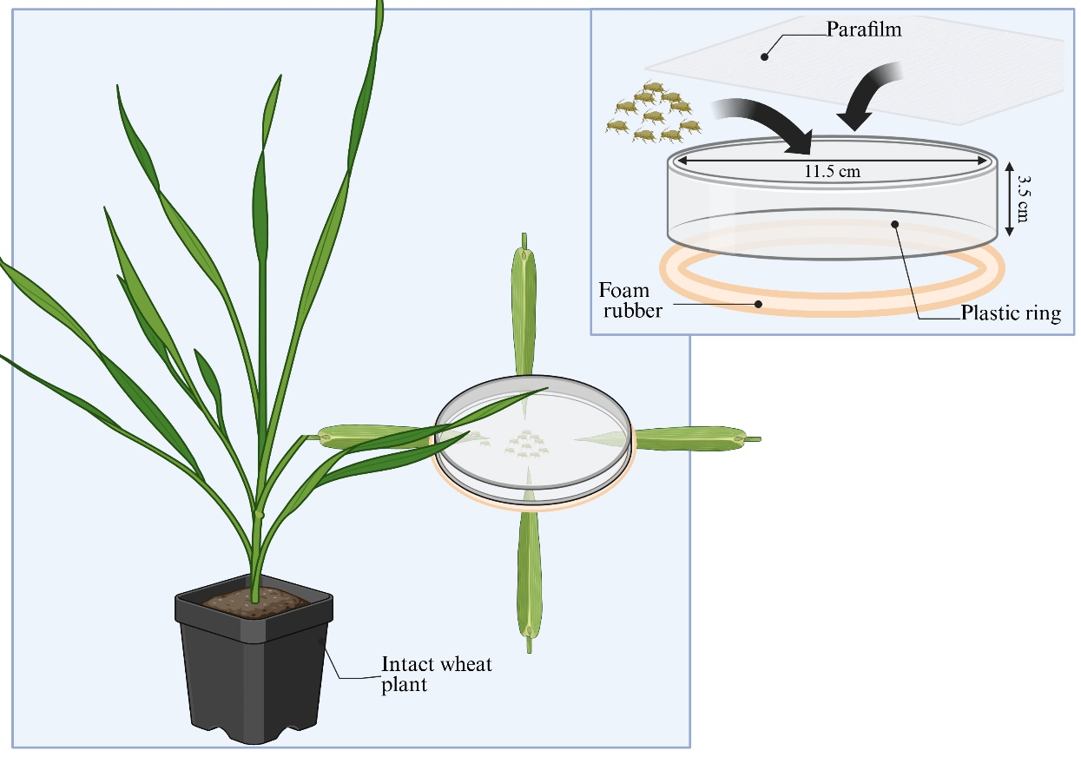
Identification of the resistance target
14
Choice experiments
(Schmidt, Will et al. Frontiers in Agricuture, 2025)

Slide 15
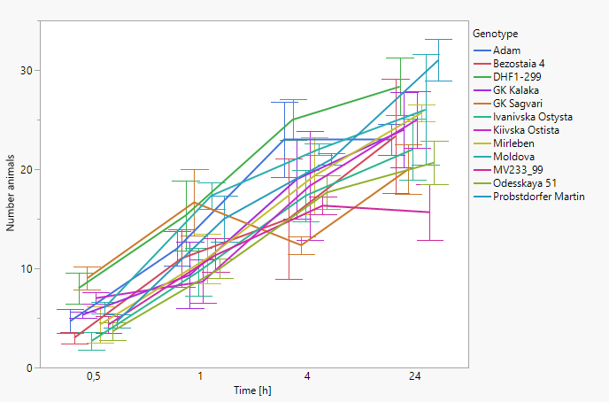
Identification of the resistance target
15
Genotype
1
2
3
4
5 (DBW020)
6
7
8
9
10
11
12 (Probstorfer Martin)
Mean number planthoppers
Number of animals is summarized over all choice experiments for the respective time points. Standard error is given.

Slide 16
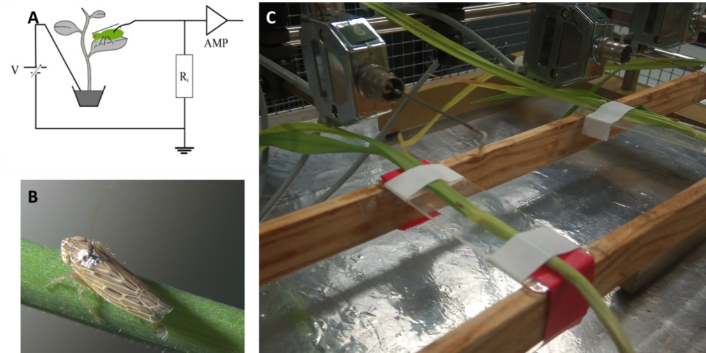
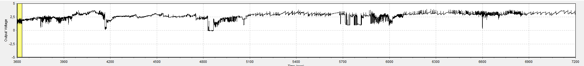
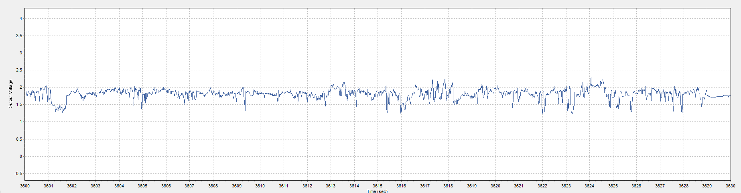
Genotype-insect interaction
16
By using the electrical penetration graph technique, we examined the feeding behaviour of P. alienus on selected genotypes in order to identify possible resistance within the genotypes.

Slide 17
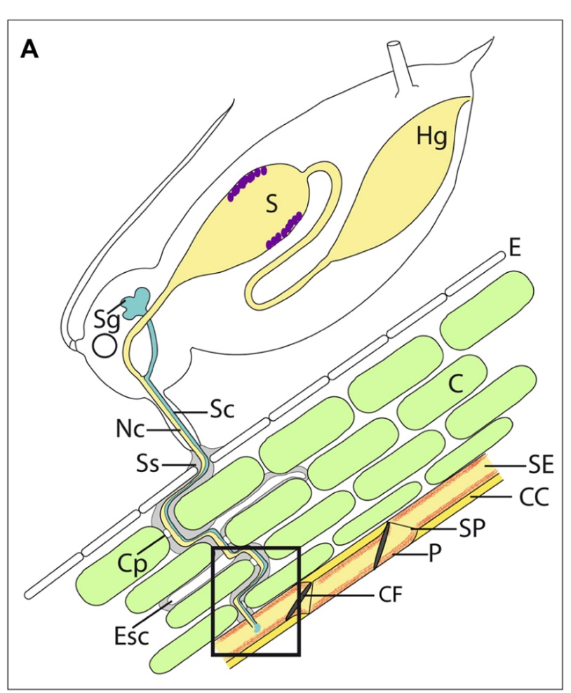
Genotype-insect interaction
17
By using the electrical penetration graph technique, we examined the feeding behaviour of P. alienus on selected genotypes in order to identify possible resistance within the genotypes.
(Will et al. Frontiers in Plant Science, 2013)

Slide 18

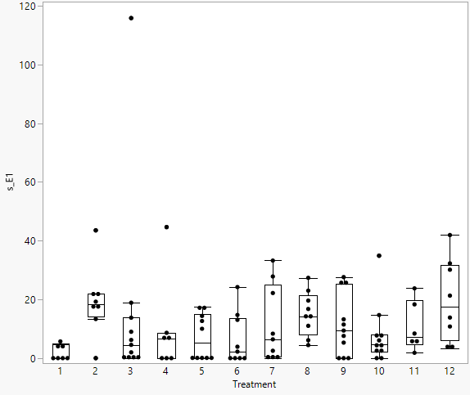
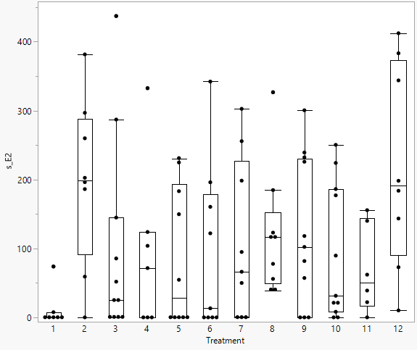

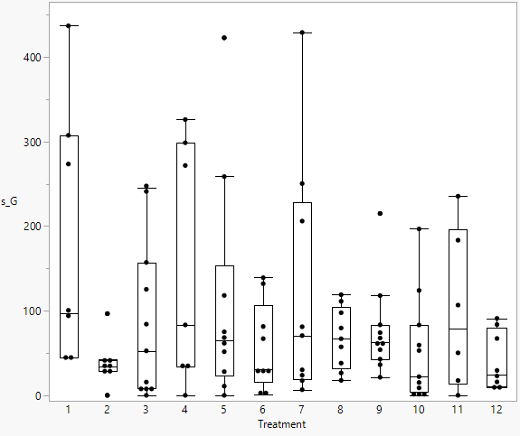
Genotype-insect interaction
18
Feeding behaviour of P. alienus indicates strong differences between genotypes.
A
C
A
BCF
s_E1 – secretion of watery saliva into SE
s_E2 – ingestion of SE sap
A
B
A
BC
(Will et al. Frontiers in Plant Science, 2013)
s_sE2 – sustained ingestion of SE sap with periods > 8 min
s_G – ingestion of xylem sap

Slide 19
Conclusions
19
Choice tests
Specific genotypes are preferred while others deter leafhoppers
Deterrence indicates that leafhoppers have problems to access feeding sites
Feeding behaviour
Problems in accessing sieve elements during recording time
Correlation with absence of WDV infection
Sieve element located leafhopper resistance

Slide 20
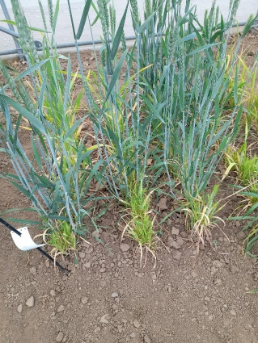
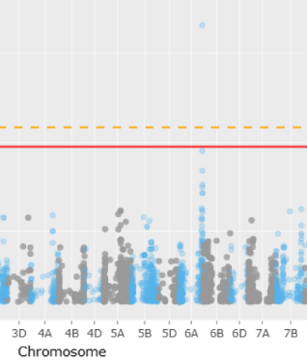
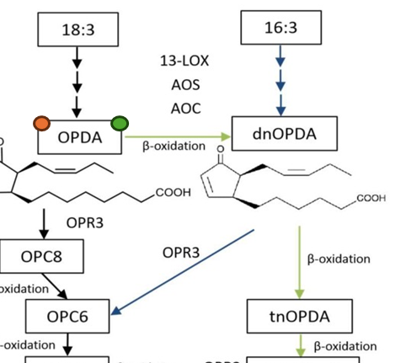
Outcomes
20
Identification of 3 highly resistant accessions (DBW020, DBW118, DBW154) and 11 genotypes with partial tolerance/resistance against WDV
QTLs:
Convergent identification of a major QTL for WDV resistance on chromosome 6A, detected both under natural field conditions and under controlled inoculation conditions
Additional QTL on 4D and 6D were identified. The genetic architecture of WDV resistance proved to be complex, involving multiple QTLs
DH were produced with 3 resistance sources. Data were not conclusive and require additional experiments
The identification of genotypes with a high level of resistance and the demonstration by EPG technique of a potential mechanism of vector resistance that has not been observed before
Increase of scientific knowledge about the topics « Virus-vector-plant interaction » and « Phytoplasma in wheat ». – Data not shown in the talk.

