Slide 1





PREDICROPT
Validation of cross progeny variance genomic prediction using simulations and experimental data in winter elite bread wheat
Bouchet Sophie
C. Oget-Ebrad, E. Heumez, L. Duchalais, E. Goudemand-Dugué, F.-X. Oury, J.-M. Elsen

Slide 2
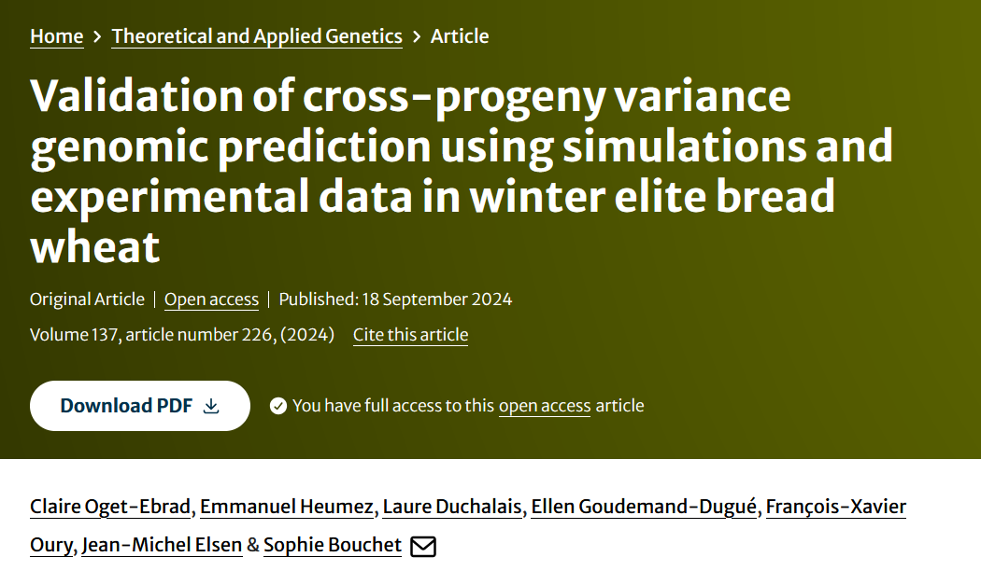
PUBLICATION

Slide 3
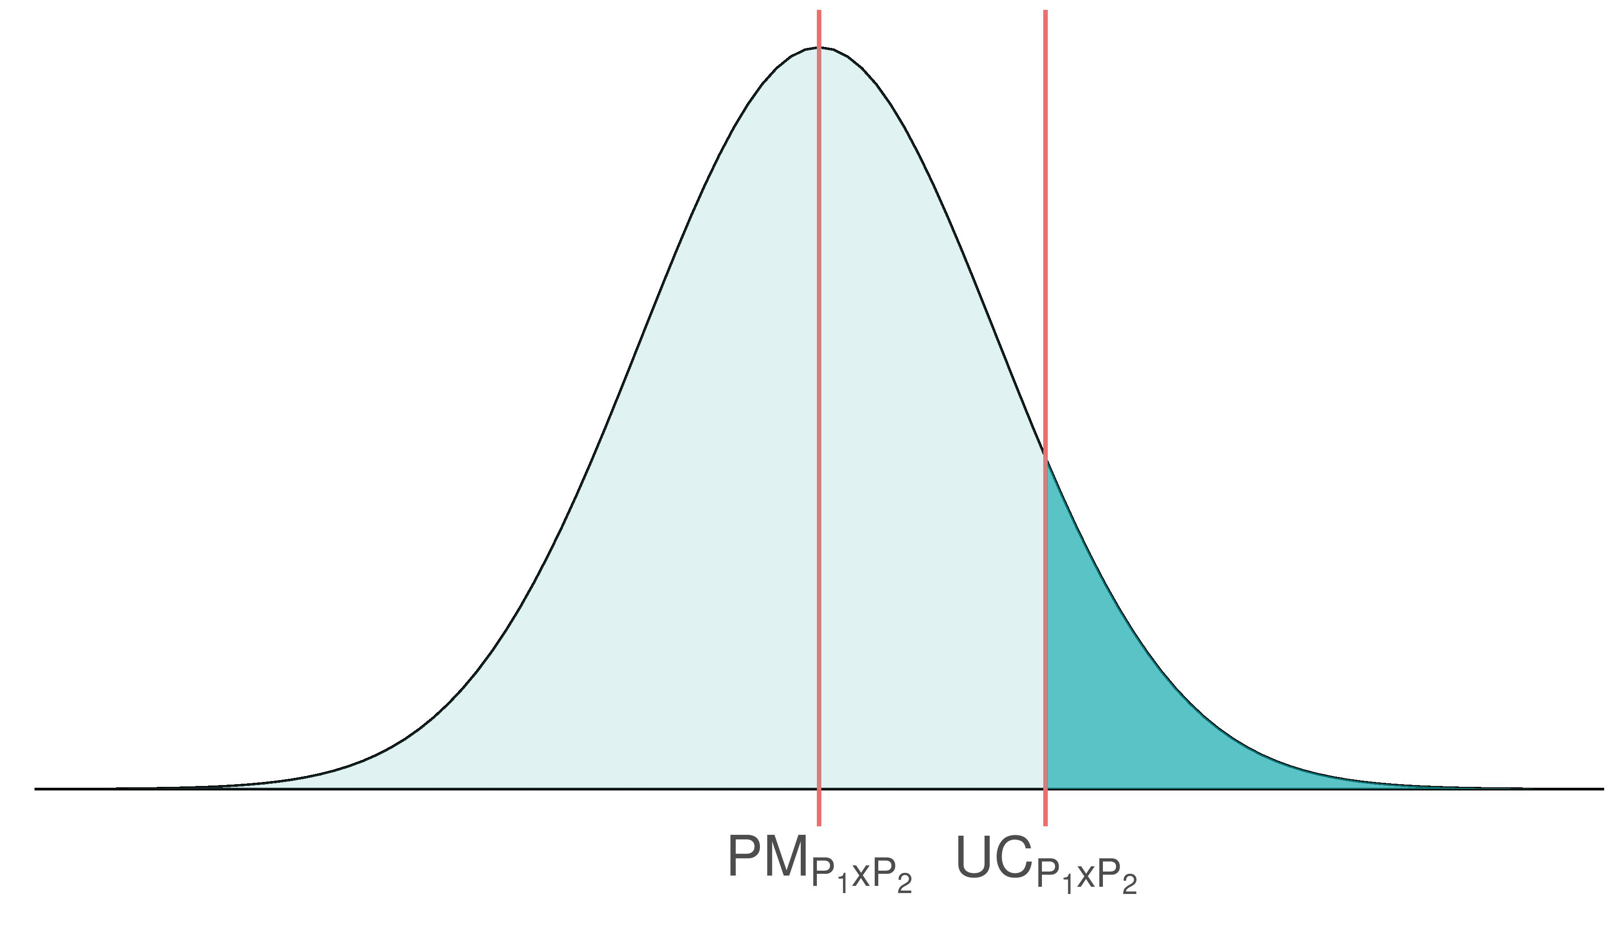
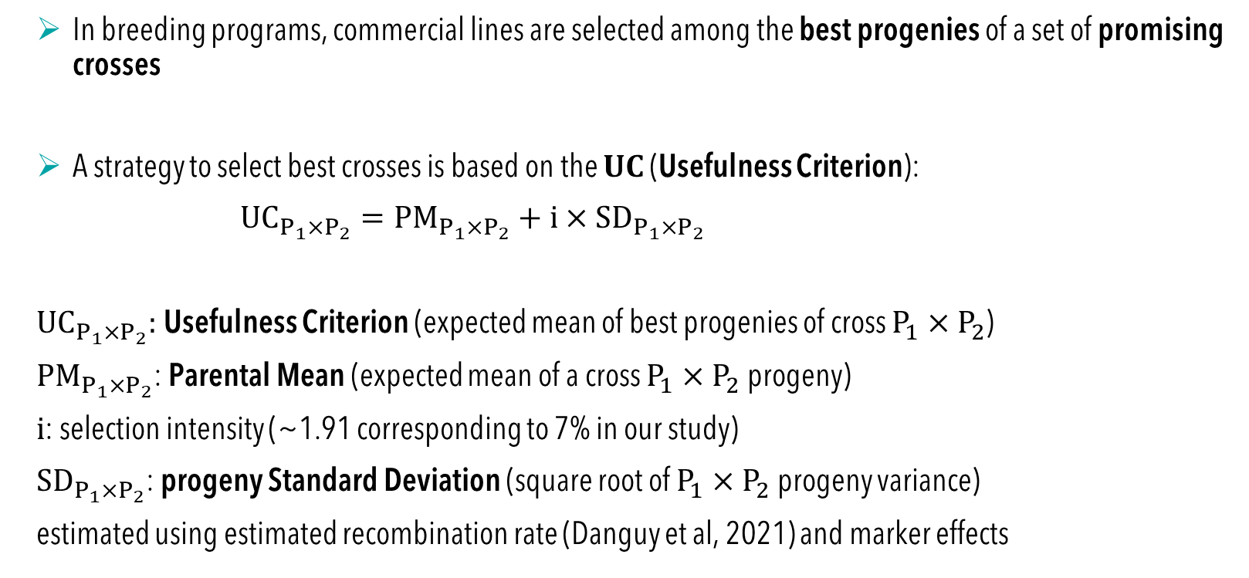
Background
In breeding programs, commercial lines are selected among the best progenies of a set of promising crosses
A strategy to select best crosses is based on the $UC$ (Usefulness Criterion):
${UC}_{P_{1}×P_{2}}={PM}_{P_{1}×P_{2}}+i×{SD}_{P_{1}×P_{2}}$
${UC}_{P_{1}×P_{2}}$: Usefulness Criterion (expected mean of best progenies of cross $P_{1}×P_{2}$)
${PM}_{P_{1}×P_{2}}$: Parental Mean (expected mean of a cross $P_{1}×P_{2}$progeny)
$i$: selection intensity (~1.91 corresponding to 7% in our study)
${SD}_{P_{1}×P_{2}}$: progeny Standard Deviation (square root of $P_{1}×P_{2}$progeny variance)
estimated using estimated recombination rate (Danguy et al, 2021) and marker effects
Breeding values of progenies
p. 2

Slide 4
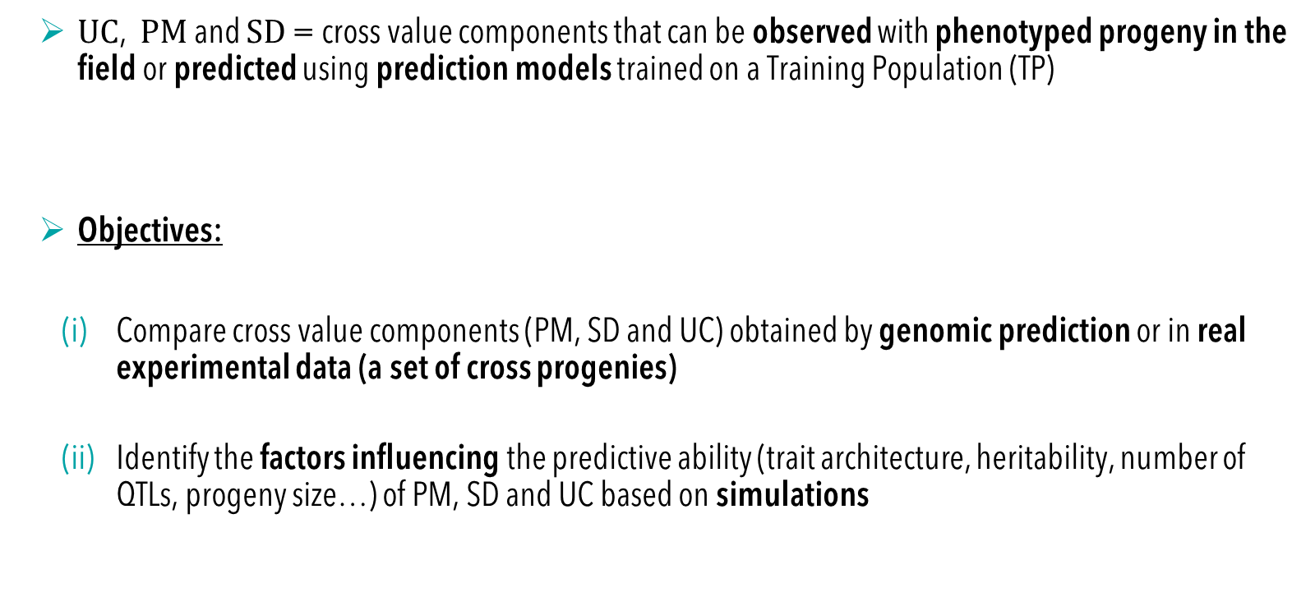
Objectives
$UC$, $PM$ and $SD$ = cross value components that can be observed with phenotyped progeny in the field or predicted using prediction models trained on a Training Population (TP)
Objectives:
  Compare cross value components (PM, SD and UC) obtained by genomic prediction or in real experimental data (a set of cross progenies)
  Identify the factors influencing the predictive ability (trait architecture, heritability, number of QTLs, progeny size…) of PM, SD and UC based on simulations
p. 3

Slide 5
Mat and Meth: Training Population (TP)
2 datasets * 2 geographical areas:
  INRAE-AO: F8-F9 winter bread wheat lines developed by INRAE-AO (2000-2022) 157-169 (North) and 26-42 (South) lines evaluated each year
  GEVES: VATE winter bread wheat data from the evaluation of varieties for national registration (2000-2022) 44-46 (North) and 26-27 (South) lines evaluated each year
Crop management methods = high yield objectives (optimized pesticide, fungicide and nitrogen amount)
p. 4

Slide 6
Mat and Meth : Training Population (TP)
2 datasets * 2 geographical areas:
  INRAE-AO: F8-F9 winter bread wheat lines developed by INRAE-AO (2000-2022) 157-169 (North) and 26-42 (South) lines evaluated each year
  GEVES: VATE winter bread wheat data from the evaluation of varieties for national registration (2000-2022) 44-46 (North) and 26-27 (South) lines evaluated each year
Crop management methods = high yield objectives (optimized pesticide, fungicide and nitrogen amount)
p. 4
AO = Agri-Obtentions
GEVES = Groupe d'Etude et de contrôle des Variétés Et des Semences (Variety and Seed Study and Control Group)
VATE = Valeur Agronomique Technologique et Environnementale
(Agronomic, technological and environmental value)

Slide 7
Mat and Meth : Training Population (TP)
2 datasets * 2 geographical areas:
  INRAE-AO: F8-F9 winter bread wheat lines developed by INRAE-AO (2000-2022) 157-169 (North) and 26-42 (South) lines evaluated each year
  CTPS: VATE winter bread wheat data from the evaluation of varieties for national registration (2000-2022) 44-46 (North) and 26-27 (South) lines evaluated each year
Crop management methods = high yield objectives (optimized pesticide, fungicide and nitrogen amount)
AO = Agri-Obtentions
GEVES = Groupe d'Etude et de contrôle des Variétés Et des Semences
(Variety and Seed Study and Control Group)
VATE = Valeur Agronomique Technologique et Environnementale (Agronomic, technological and environmental value)
p. 4

Slide 8
Mat and Meth : Training Population (TP)
2 datasets * 2 geographical areas:
  INRAE-AO: F8-F9 winter bread wheat lines developed by INRAE-AO (2000-2022) 157-169 (North) and 26-42 (South) lines evaluated each year
  CTPS: VATE winter bread wheat data from the evaluation of varieties for national registration (2000-2022) 44-46 (North) and 26-27 (South) lines evaluated each year
Crop management methods = high yield objectives (optimized pesticide, fungicide and nitrogen amount)
Crop management methods = high yield objectives (optimized pesticide, fungicide and nitrogen amount)
AO = Agri-Obtentions
GEVES = Groupe d'Etude et de contrôle des Variétés Et des Semences
(Variety and Seed Study and Control Group)
VATE = Valeur Agronomique Technologique et Environnementale (Agronomic, technological and environmental value)
p. 4

Slide 9
Mat and Meth : Training Population (TP)
2 datasets * 2 geographical areas:
  INRAE-AO: F8-F9 winter bread wheat lines developed by INRAE-AO (2000-2022) 157-169 (North) and 26-42 (South) lines evaluated each year
  CTPS: VATE winter bread wheat data from the evaluation of varieties for national registration (2000-2022) 44-46 (North) and 26-27 (South) lines evaluated each year
Crop management methods = high yield objectives (optimized pesticide, fungicide and nitrogen amount)
Crop management methods = high yield objectives (optimized pesticide, fungicide and nitrogen amount)
Trait | Number of lines with phenotypes + genotypes (23K markers)
Yield | 2,146
Grain protein content | 2,062
Plant height | 2,126
Heading date | 2,145
AO = Agri-Obtentions
GEVES = Groupe d'Etude et de contrôle des Variétés Et des Semences
(Variety and Seed Study and Control Group)
VATE = Valeur Agronomique Technologique et Environnementale (Agronomic, technological and environmental value)
p. 4

Slide 10
Mat and Meth : real experimental data (1/2)
FD = Florimond-Desprez CF = Clermont-Ferrand (INRAE PHACC) EM = Estrées-Mons (INRAE GCIE) AO = Agri-Obtentions
CAP = Cappelle (FD) HOU = Houville (FD) LU = Lusignan (INRAE FERLUS) AUZ = Auzeville (INRAE GCA)
Number of crosses | 2020 | 2021 | 2022 | Total
FD | 8 | 8 | 0 | 16
CF | 0 | 0 | 7 | 7
EM | 5 | 21 | 11 | 37
AO | 12 | 20 | 10 | 42
Total | 25 | 49 | 28 | 102
From 8 to 122 progenies per cross (mean: 54.8)
p. 5

Slide 11
Mat and Meth : real experimental data (1/2)
FD = Florimond-Desprez CF = Clermont-Ferrand (INRAE PHACC) EM = Estrées-Mons (INRAE GCIE) AO = Agri-Obtentions
CAP = Cappelle (FD) HOU = Houville (FD) LU = Lusignan (INRAE FERLUS) AUZ = Auzeville (INRAE GCA)
Number of crosses | 2020 | 2021 | 2022 | Total
FD | 8 | 8 | 0 | 16
CF | 0 | 0 | 7 | 7
EM | 5 | 21 | 11 | 37
AO | 12 | 20 | 10 | 42
Total | 25 | 49 | 28 | 102
Parcelles | 2020-2021 | 2021-2022 | 2022-2023 | 2023-2024 | Total
INRAE UE PHACC | 0 | 789 | 804 | 0 | 1 593
INRAE UE GCIE | 483 | 790 | 1 008 | 0 | 2 281
INRAE UE FERLUS | 420 | 834 | 1 008 | 0 | 2 262
INRAE UE GCA | 416 | 0 | 820 | 450 | 1 686
FLORIMOND-DESPREZ | 916 | 689 | 300 | 0 | 1 905
Total | 2 235 | 3 102 | 3 940 | 450 | 9 727
From 8 to 122 progenies per cross (mean: 54.8)
p. 5

Slide 12
Results: Training Population (TP) quality
Genotypes:
  After quality control (MAF & call rate) and imputation of missing genotypes → 2,146 lines and 23,140 markers
Phenotypes (BLUE values):
  Means of correlations between years: 0.69 (yield), 0.78 (grain protein content), 0.87 (plant height), 0.91 (heading date)
p. 11

Slide 13
Results: Training Population (TP) quality
Genotypes:
  After quality control (MAF & call rate) and imputation of missing genotypes → 2,146 lines and 23,140 markers
Phenotypes (BLUE values):
  Means of correlations between years: 0.69 (yield), 0.78 (grain protein content), 0.87 (plant height), 0.91 (heading date)
p. 11

Slide 14
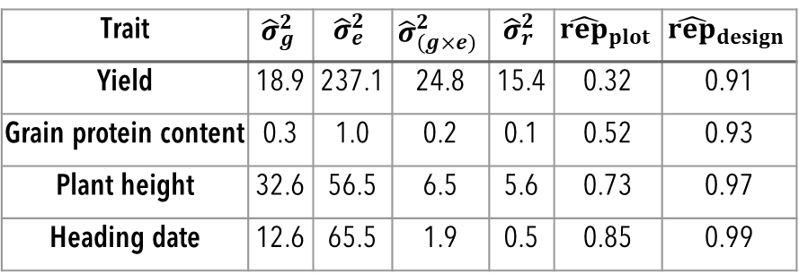
Results: Training Population (TP) quality
Genotypes:
  After quality control (MAF & call rate) and imputation of missing genotypes → 2,146 lines and 23,140 markers
Phenotypes (BLUE values):
  Means of correlations between years: 0.69 (yield), 0.78 (grain protein content), 0.87 (plant height), 0.91 (heading date)
Trait | $${\hat{σ}}_{g}^{2}$$ | $${\hat{σ}}_{e}^{2}$$ | $${\hat{σ}}_{\left(g×e\right)}^{2}$$ | $${\hat{σ}}_{r}^{2}$$ | $${\hat{rep}}_{plot}$$ | $${\hat{rep}}_{design}$$
Yield | 18.9 | 237.1 | 24.8 | 15.4 | 0.32 | 0.91
Grain protein content | 0.3 | 1.0 | 0.2 | 0.1 | 0.52 | 0.93
Plant height | 32.6 | 56.5 | 6.5 | 5.6 | 0.73 | 0.97
Heading date | 12.6 | 65.5 | 1.9 | 0.5 | 0.85 | 0.99
Model | Yield | Prot | Plant Height | Heading Date
BayesA | 0.62 | 0.6 | 0.6 | 0.81
rrBLUP | 0.62 | 0.52 | 0.6 | 0.65
Repetability of measures
Predictive ability (cross validations)
p. 11

Slide 15
Results: correlation genomic vs experimental predictions
Trait | cor_year | rep_plot | h²_genome
Yield | 0.48 | 0.32 | 0.53
Prot | 0.43 | 0.52 | 0.51
Plant Height | 0.79 | 0.73 | 0.56
Heading Date | 0.88 | 0.85 | 0.73
Repeatability of measures

Slide 16
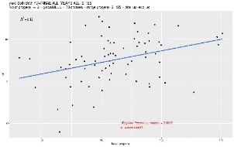
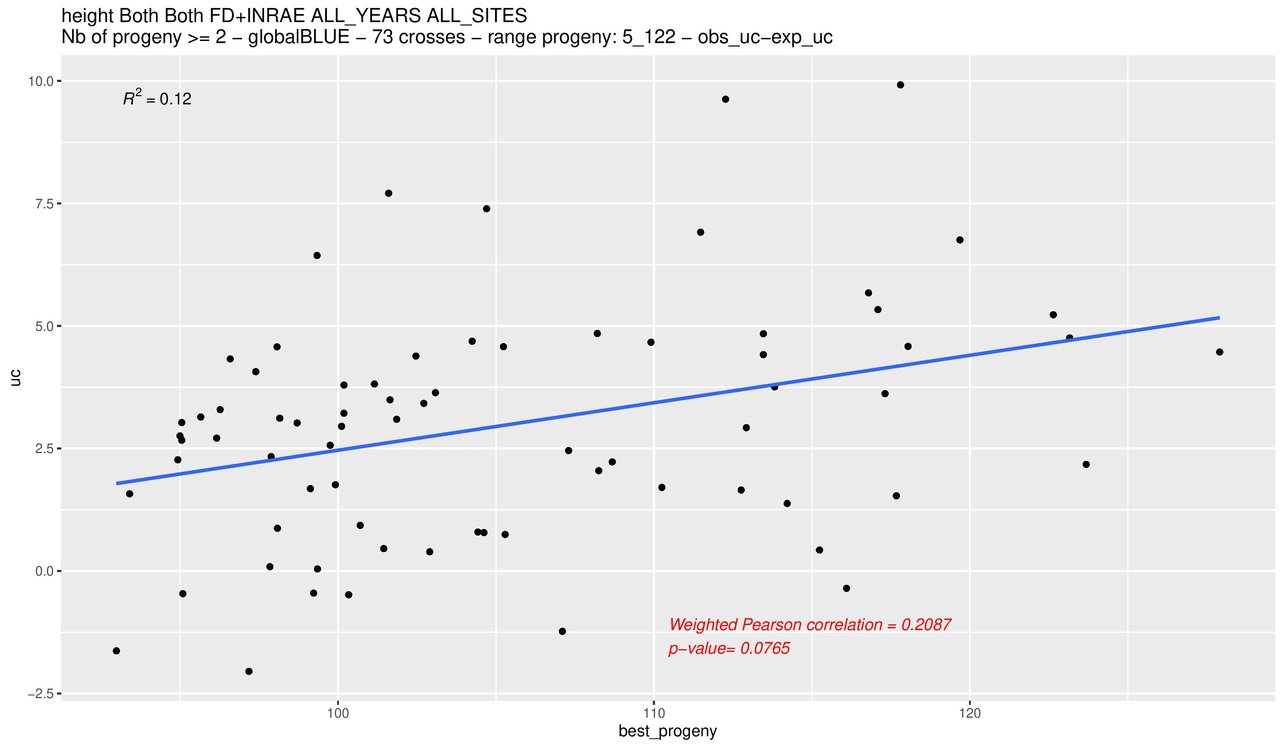
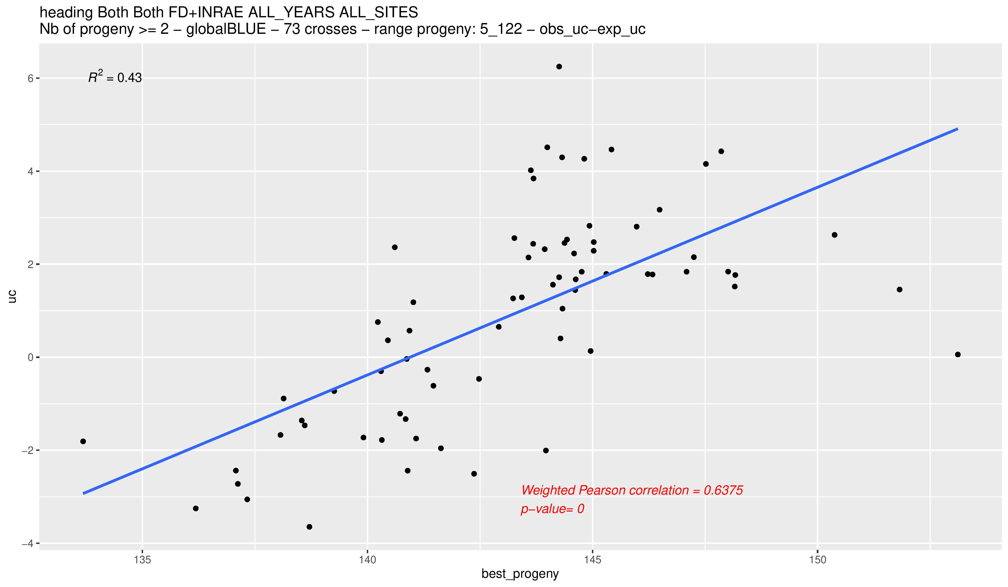
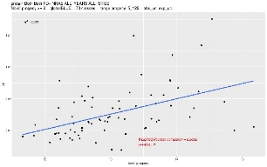
Results: correlation genomic vs experimental predictions
Yield
Plant Height
UC 7%
 | PM | SD | UC
Yield | 0.38 | 0.05 | 0.47
GPC | 0.62 | 0.26 | 0.52
Plant Height | 0.51 | 0.64 | 0.66
Heading Date | 0.92 | 0.46 | 0.7
Heading Date
Protein Content
UC 7%
Correlation observed/predictions
Phenotype top 7%
Phenotype top 7%
Phénotype 7% meilleurs

Slide 17
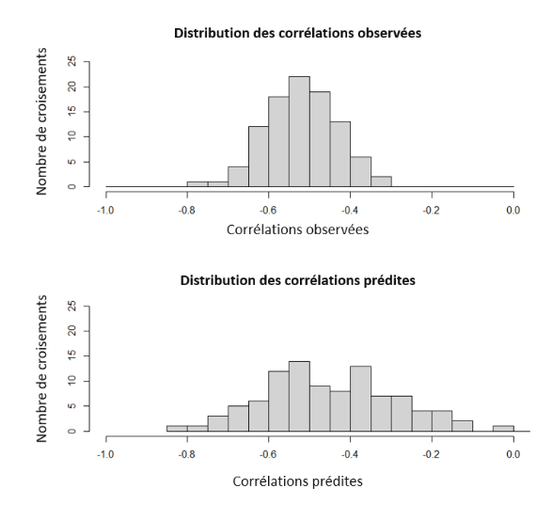
Results: prediction of correlations
Cor (cor(obs), cor(pred)) | rrBLUP | BayesA
Plant Height/Yield | 0.27 | 0.16
Protein /Yield | 0.39 | 0.38
Heading Date /Yield | 0.61 | 0.65

Slide 18
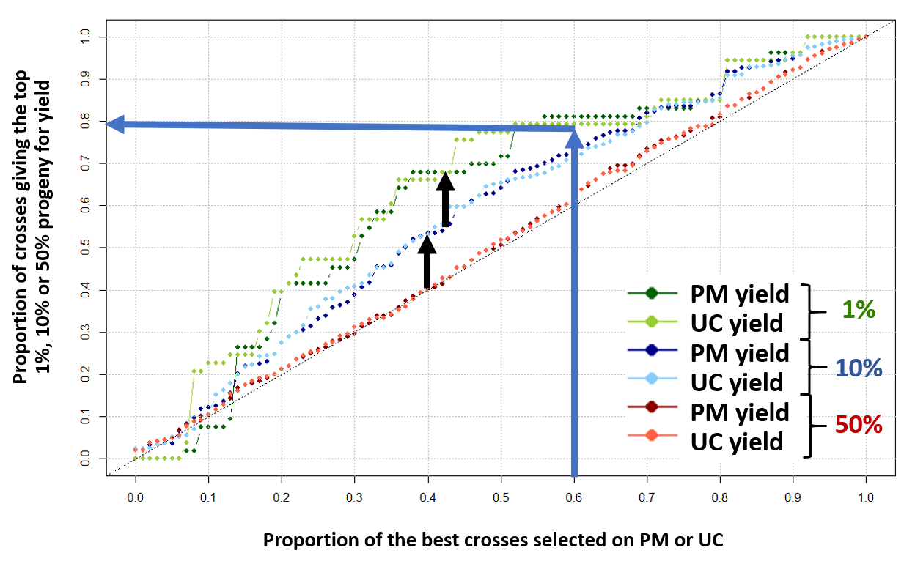
Choose best elite crosses

Slide 19
Why correlations between field and genomic predictions are not very high, especially SD?
genetic architecture?
GxE?
population size? size of the experiment?
We run simulations to better understand our predictive ability

Slide 20

Mat and Meth : cross value components predictive ability
Analytic formulae (genomic predictions) (2/2)
Different prediction models were tested to estimate marker effects: BayesA, BayesB, BayesC, Bayesian Lasso (BL), Bayesian Ridge Regression (BRR), Ridge Regression BLUP ( )
We developed 2 alternative approaches to compute gametic variance (tested only with Ridge Regression BLUP):
  ${\left({\hat{SD}}_{P_{1}×P_{2}}^{2}\right)}_{{Vg}_{2}}={Vg}_{1}+\text{term} \text{for} \text{marker} \text{effect} \text{estimation} \text{error}$
  Considering that the uncertainty of the estimation of marker effects is modulated by the genomic constitution of each parent:
${\left({\hat{SD}}_{P_{1}×P_{2}}^{2}\right)}_{{Vg}_{3}}={Vg}_{2}+\text{term} \text{for} \text{genomic} \text{constitution} \text{of} \text{each} \text{parent}$
Vg1
p. 8

Slide 21
Mat and Meth : simulation design
TP = Training Population
QTL = Quantitative Trait Loci
TBV = True Breeding Value
Predictions
Analytic formulae
Observations
Simulation of progenies
p. 10

Slide 22
Mat and Meth : simulation design
Predictions
Analytic formulae
Observations
Simulation of progenies
TP: 2,146 lines
Real genotypes
TP = Training Population
QTL = Quantitative Trait Loci
TBV = True Breeding Value
p. 10

Slide 23
Mat and Meth : simulation design
Predictions
Analytic formulae
Observations
Simulation of progenies
TP: 2,146 lines
Real genotypes
True marker effects x20
TP = Training Population
QTL = Quantitative Trait Loci
TBV = True Breeding Value
p. 10

Slide 24
Mat and Meth : simulation design
Predictions
Analytic formulae
Observations
Simulation of progenies
TP: 2,146 lines
Real genotypes
heritability
number of QTL
True marker effects x20
TP = Training Population
QTL = Quantitative Trait Loci
QTL = Quantitative Trait Loci
TBV = True Breeding Value
p. 10

Slide 25
Mat and Meth : simulation design
Predictions
Analytic formulae
Observations
Simulation of progenies
TP: 2,146 lines
Real genotypes
heritability
number of QTL
True marker effects x20
pred_true
cross value components
TP = Training Population
QTL = Quantitative Trait Loci
QTL = Quantitative Trait Loci
TBV = True Breeding Value
p. 10

Slide 26
Mat and Meth : simulation design
Predictions
Analytic formulae
Observations
Simulation of progenies
TP: 2,146 lines
Real genotypes
heritability
number of QTL
True marker effects x20
TP TBV
pred_true
cross value components
TP = Training Population
QTL = Quantitative Trait Loci
TBV = True Breeding Value
QTL = Quantitative Trait Loci
TBV = True Breeding Value
p. 10

Slide 27
Mat and Meth : simulation design
Predictions
Analytic formulae
Observations
Simulation of progenies
TP: 2,146 lines
Real genotypes
heritability
number of QTL
True marker effects x20
TP TBV
TP Phenotypes
pred_true
cross value components
TP = Training Population
QTL = Quantitative Trait Loci
TBV = True Breeding Value
QTL = Quantitative Trait Loci
TBV = True Breeding Value
p. 10

Slide 28
Mat and Meth : simulation design
Predictions
Analytic formulae
Observations
Simulation of progenies
TP: 2,146 lines
Real genotypes
heritability
number of QTL
True marker effects x20
TP TBV
TP Phenotypes
Estimated marker effects
pred_true
cross value components
TP = Training Population
QTL = Quantitative Trait Loci
TBV = True Breeding Value
QTL = Quantitative Trait Loci
TBV = True Breeding Value
p. 10

Slide 29
Mat and Meth : simulation design
Predictions
Analytic formulae
Observations
Simulation of progenies
TP: 2,146 lines
Real genotypes
heritability
number of QTL
model of prediction
True marker effects x20
TP TBV
TP Phenotypes
Estimated marker effects
pred_true
cross value components
TP = Training Population
QTL = Quantitative Trait Loci
TBV = True Breeding Value
QTL = Quantitative Trait Loci
TBV = True Breeding Value
p. 10

Slide 30
Mat and Meth : simulation design
Predictions
Analytic formulae
Observations
Simulation of progenies
TP: 2,146 lines
Real genotypes
heritability
number of QTL
model of prediction
True marker effects x20
TP TBV
TP Phenotypes
Estimated marker effects
pred_true
cross value components
pred_estimated
cross value components
TP = Training Population
QTL = Quantitative Trait Loci
TBV = True Breeding Value
QTL = Quantitative Trait Loci
TBV = True Breeding Value
p. 10

Slide 31
Mat and Meth : simulation design
Predictions
Analytic formulae
Observations
Simulation of progenies
TP: 2,146 lines
Real genotypes
73 crosses
Real genotypes
heritability
number of QTL
model of prediction
True marker effects x20
TP TBV
TP Phenotypes
Estimated marker effects
pred_true
cross value components
pred_estimated
cross value components
TP = Training Population
QTL = Quantitative Trait Loci
TBV = True Breeding Value
QTL = Quantitative Trait Loci
TBV = True Breeding Value
p. 10

Slide 32
Mat and Meth : simulation design
Predictions
Analytic formulae
Observations
Simulation of progenies
TP: 2,146 lines
Real genotypes
73 crosses
Real genotypes
heritability
number of QTL
model of prediction
True marker effects x20
TP TBV
TP Phenotypes
Estimated marker effects
Progeny simulated genotypes x25
pred_true
cross value components
pred_estimated
cross value components
TP = Training Population
QTL = Quantitative Trait Loci
TBV = True Breeding Value
QTL = Quantitative Trait Loci
TBV = True Breeding Value
p. 10

Slide 33
Mat and Meth : simulation design
Predictions
Analytic formulae
Observations
Simulation of progenies
TP: 2,146 lines
Real genotypes
73 crosses
Real genotypes
heritability
number of QTL
model of prediction
number of progenies per cross
True marker effects x20
TP TBV
TP Phenotypes
Estimated marker effects
Progeny simulated genotypes x25
pred_true
cross value components
pred_estimated
cross value components
TP = Training Population
QTL = Quantitative Trait Loci
TBV = True Breeding Value
QTL = Quantitative Trait Loci
TBV = True Breeding Value
p. 10

Slide 34
Mat and Meth : simulation design
Predictions
Analytic formulae
Observations
Simulation of progenies
TP: 2,146 lines
Real genotypes
73 crosses
Real genotypes
heritability
number of QTL
model of prediction
number of progenies per cross
True marker effects x20
TP TBV
TP Phenotypes
Estimated marker effects
Progeny simulated genotypes x25
Progeny TBV
pred_true
cross value components
pred_estimated
cross value components
TP = Training Population
QTL = Quantitative Trait Loci
TBV = True Breeding Value
QTL = Quantitative Trait Loci
TBV = True Breeding Value
p. 10

Slide 35
Mat and Meth : simulation design
Predictions
Analytic formulae
Observations
Simulation of progenies
TP: 2,146 lines
Real genotypes
73 crosses
Real genotypes
heritability
number of QTL
model of prediction
number of progenies per cross
True marker effects x20
TP TBV
TP Phenotypes
Estimated marker effects
Progeny simulated genotypes x25
Progeny TBV
Progeny phenotypes
pred_true
cross value components
pred_estimated
cross value components
TP = Training Population
QTL = Quantitative Trait Loci
TBV = True Breeding Value
QTL = Quantitative Trait Loci
TBV = True Breeding Value
p. 10

Slide 36
Mat and Meth : simulation design
Predictions
Analytic formulae
Observations
Simulation of progenies
TP: 2,146 lines
Real genotypes
73 crosses
Real genotypes
heritability
number of QTL
model of prediction
number of progenies per cross
True marker effects x20
TP TBV
TP Phenotypes
Estimated marker effects
Progeny simulated genotypes x25
Progeny TBV
Progeny phenotypes
pred_true
cross value components
pred_estimated
cross value components
progeny_phenotypes
cross value components
TP = Training Population
QTL = Quantitative Trait Loci
TBV = True Breeding Value
QTL = Quantitative Trait Loci
TBV = True Breeding Value
p. 10

Slide 37
Mat and Meth : simulation design
Predictions
Analytic formulae
Observations
Simulation of progenies
TP: 2,146 lines
Real genotypes
73 crosses
Real genotypes
heritability
number of QTL
model of prediction
number of progenies per cross
True marker effects x20
TP TBV
TP Phenotypes
Estimated marker effects
Progeny simulated genotypes x25
Progeny TBV
Progeny phenotypes
pred_true
cross value components
pred_estimated
cross value components
progeny_phenotypes
cross value components
Weighted Pearson’s correlation
TP = Training Population
QTL = Quantitative Trait Loci
TBV = True Breeding Value
QTL = Quantitative Trait Loci
TBV = True Breeding Value
p. 10

Slide 38
Mat and Meth : simulation design
Predictions
Analytic formulae
Observations
Simulation of progenies
parents of crosses
TP: 2,146 lines
Real genotypes
73 crosses
Real genotypes
heritability
number of QTL
model of prediction
number of progenies per cross
True marker effects x20
TP TBV
TP Phenotypes
Estimated marker effects
Progeny simulated genotypes x25
Progeny TBV
Progeny phenotypes
pred_true
cross value components
pred_estimated
cross value components
progeny_phenotypes
cross value components
Weighted Pearson’s correlation
TP = Training Population
QTL = Quantitative Trait Loci
TBV = True Breeding Value
QTL = Quantitative Trait Loci
TBV = True Breeding Value
p. 10

Slide 39
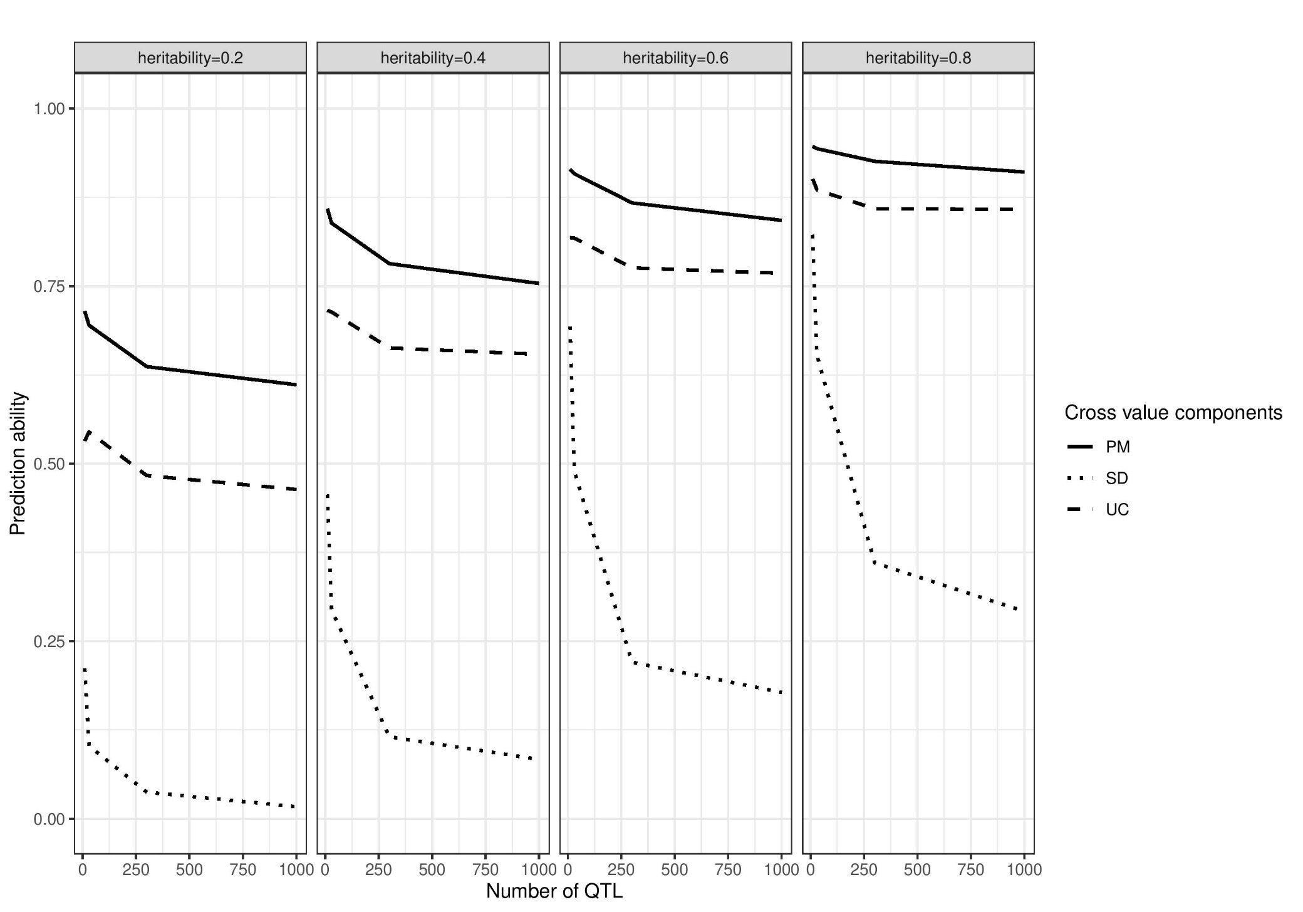
Results: predictive ability and genetic architecture
Number of progenies per cross as in experimental data
Marker effects estimated with BayesA
simulations
p. 12

Slide 40
Results: predictive ability and genetic architecture
Number of progenies per cross as in experimental data
Marker effects estimated with BayesA
simulations
p. 12

Slide 41
Results: predictive ability and genetic architecture
Number of progenies per cross as in experimental data
Marker effects estimated with BayesA
simulations
p. 12

Slide 42
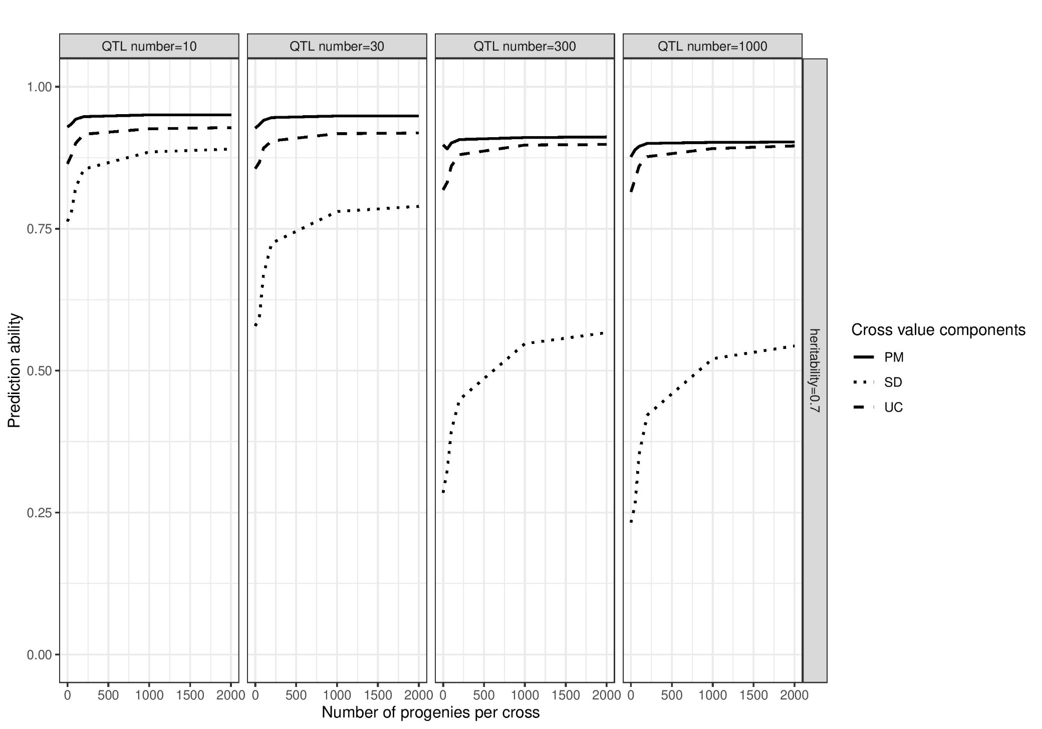
Results: predictive ability and progeny size
0=number of progenies per cross as in experimental data
Marker effects estimated with BayesA
simulations
p. 13

Slide 43
Results: predictive ability and progeny size
0=number of progenies per cross as in experimental data
Marker effects estimated with BayesA
simulations
p. 13

Slide 44
Results: predictive ability and progeny size
0=number of progenies per cross as in experimental data
Marker effects estimated with BayesA
simulations
p. 13

Slide 45
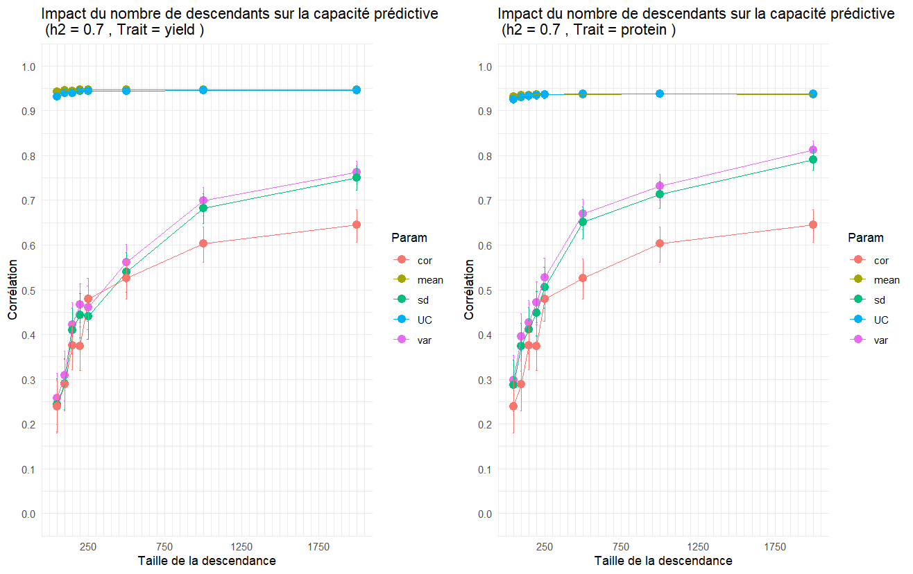

Results: correlation predictive ability and progeny size
Impact of the number of progenies per cross on
the predictive ability for GY (left) and GPC (right)
r_{G}
PM
$$σ$$
UC
$$σ^{2}$$
Correlation between simulated phenotypes (h² = 0.7) and predictions
Number of progenies per cross
Number of progenies per cross

Slide 46
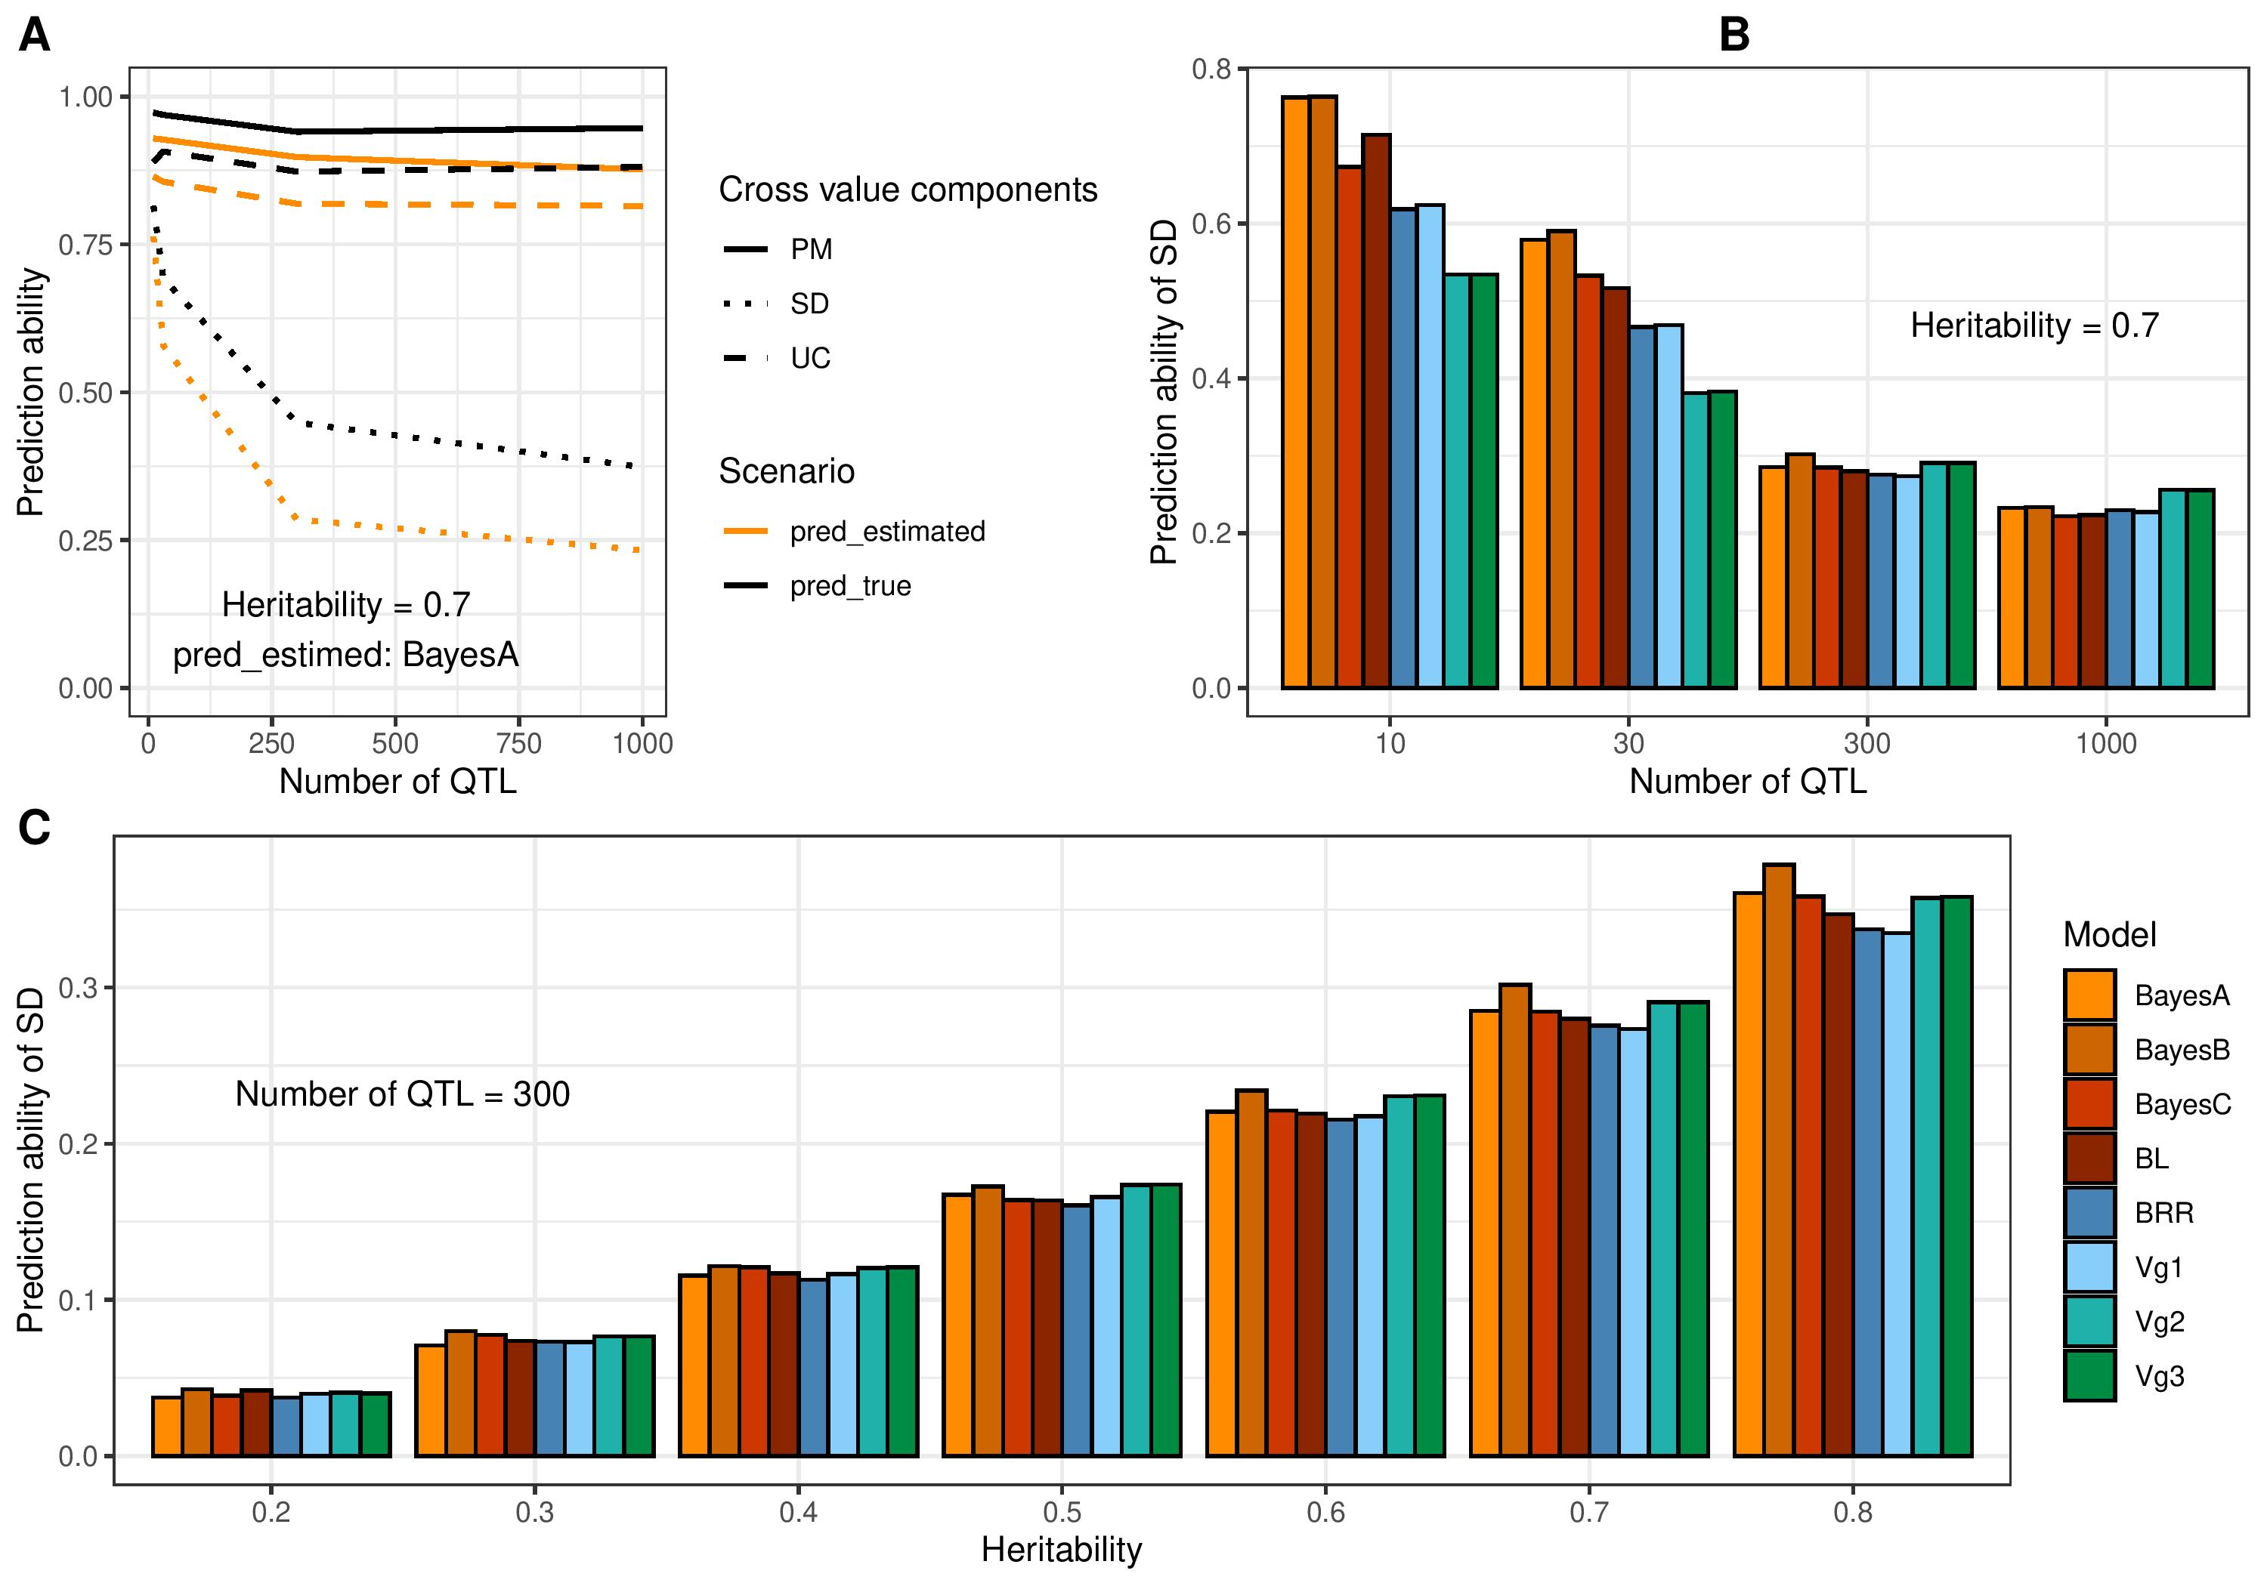
Results: predictive ability and marker effect precision
Number of progenies per cross as in experimental data
simulations
p. 14
Notes:
Pourquoi on est moins bon avec vg2 et vg3 quand on a peu de qtls?

Slide 47
Results: predictive ability and marker effect precision
Number of progenies per cross as in experimental data
simulations
p. 14

Slide 48
Results: predictive ability and marker effect precision
Number of progenies per cross as in experimental data
simulations
p. 14

Slide 49
Results: predictive ability and marker effect precision
Number of progenies per cross as in experimental data
simulations
p. 14

Slide 50
Results: predictive ability and marker effect precision
Number of progenies per cross as in experimental data
simulations
p. 14

Slide 51
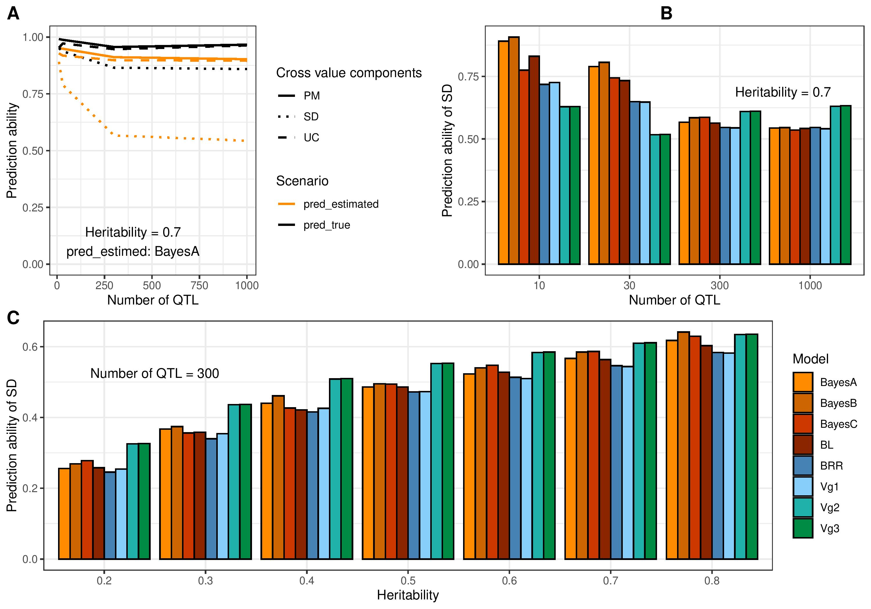
Results: predictive ability and marker effect precision
Number of progenies per cross = 2,000
simulations
p. 15

Slide 52
Results: predictive ability and marker effect precision
Number of progenies per cross = 2,000
simulations
p. 15

Slide 53
Results: predictive ability and marker effect precision
Number of progenies per cross = 2,000
simulations
p. 15

Slide 54
Results: predictive ability and marker effect precision
Number of progenies per cross = 2,000
simulations
p. 15

Slide 55
Take-home message
Parameters impacting the prediction abilities of PM, SD and UC (simulations):
  Genetic architecture = factor with the strongest impact
  Very strong impact of the number of progenies per cross
  SD difficult to predict even in "true" scenarios ~ infinite TP size (with small number of progenies per cross)
  Very little impact of marker effect estimation model
  Little/no impact of selected crosses
Application on real experimental data:
  PM and UC were correctly predicted for the 4 traits
  SD correctly predicted for plant height and heading date and badly predicted for yield and grain protein content (GxE?)
Recommendations for crossbreeding plans: selecting on UC and generating a very large number of progenies for a very small number of crosses would make it possible to obtain the most promising offspring?
p. 20

Slide 56
Take-home message
Parameters impacting the prediction abilities of PM, SD and UC (simulations):
  Genetic architecture = factor with the strongest impact
  Very strong impact of the number of progenies per cross
  SD difficult to predict even in "true" scenarios ~ infinite TP size (with small number of progenies per cross)
  Very little impact of marker effect estimation model, except Vg3 when the number of QTL >300, especially when heritability is low
  Little/no impact of selected crosses: try with higher germplasm diversity (genetic ressources)
Application on real experimental data:
  PM and UC were correctly predicted for the 4 traits
  SD correctly predicted for plant height and heading date and badly predicted for yield and grain protein content (GxE?)
Recommendations for crossbreeding plans: selecting on UC and generating a very large number of progenies for a very small number of crosses would make it possible to obtain the most promising offspring?
p. 20

Slide 57
Take-home message
Parameters impacting the prediction abilities of PM, SD and UC (simulations):
  Genetic architecture = factor with the strongest impact
  Very strong impact of the number of progenies per cross
  SD difficult to predict even in "true" scenarios ~ infinite TP size (with small number of progenies per cross)
  Very little impact of marker effect estimation model
  Taking into account the error in marker effect estimates improved SD predictions for quantitative traits with low heritability
  Little/no impact of selected crosses
Application on real experimental data:
  PM and UC were correctly predicted for the 4 traits
  SD correctly predicted for plant height and heading date and badly predicted for yield and grain protein content (GxE?)
Recommendations for crossbreeding plans: selecting on UC and generating a very large number of progenies for a very small number of crosses would make it possible to obtain the most promising offspring?
p. 20

Slide 58
Take-home message
Parameters impacting the prediction abilities of PM, SD and UC (simulations):
  Genetic architecture = factor with the strongest impact
  Very strong impact of the number of progenies per cross
  SD difficult to predict even in "true" scenarios ~ infinite TP size (with small number of progenies per cross)
  Very little impact of marker effect estimation model
  Taking into account the error in marker effect estimates improved SD predictions for quantitative traits with low heritability
  Little/no impact of selected crosses
Application on real experimental data:
  PM and UC were correctly predicted for the 4 traits
  SD correctly predicted for plant height and heading date and badly predicted for yield and grain protein content (GxE?)
Recommendations for crossbreeding plans: selecting on UC and generating a very large number of progenies for a very small number of crosses would make it possible to obtain the most promising offspring?
p. 20

Slide 59
Take-home message
Parameters impacting the prediction abilities of PM, SD and UC (simulations):
  Genetic architecture = factor with the strongest impact
  Very strong impact of the number of progenies per cross
  SD difficult to predict even in "true" scenarios ~ infinite TP size (with small number of progenies per cross)
  Very little impact of marker effect estimation model
  Taking into account the error in marker effect estimates improved SD predictions for quantitative traits with low heritability
  Little/no impact of selected crosses
Application on real experimental data:
  PM and UC were correctly predicted for the 4 traits
  SD correctly predicted for plant height and heading date and badly predicted for yield and grain protein content (GxE?)
Recommendations for crossbreeding plans: selecting on UC and generating a very large number of progenies for a very small number of crosses would make it possible to obtain the most promising offspring?
p. 20

Slide 60
Perspective
Is our predictive ability sufficient for significant genetic gain in a breeding program (elite material) or pre-breeding (more diverse material)?
Observation: the correlation between yield and protein content is variable (between cross, between material: old cultivars and modern varieties)
Can we better control the correlation between traits using genomic prediction to design mating plans?

Slide 62
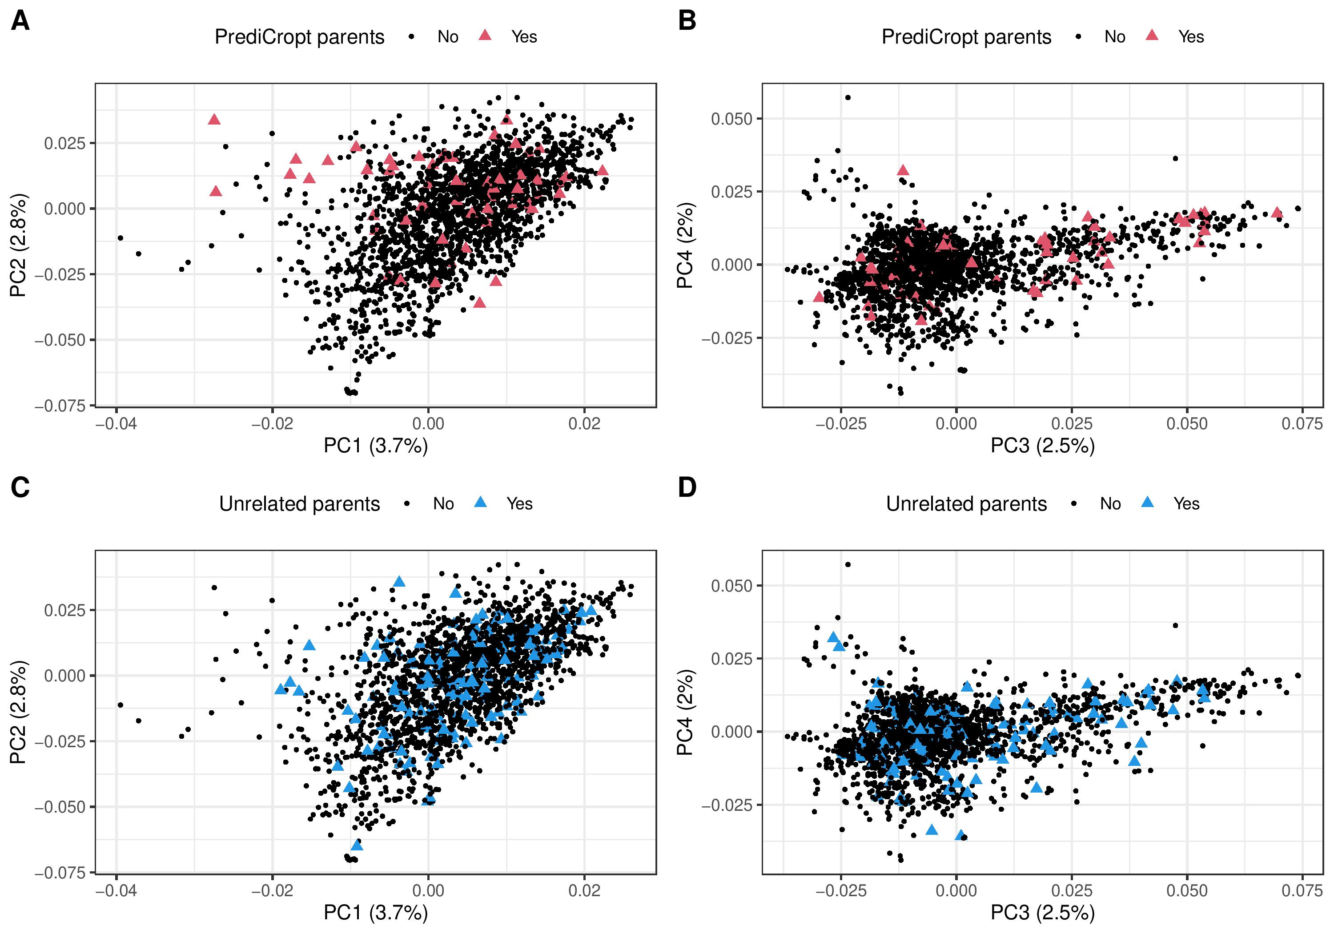
Results: genetic constitution of parents
simulations
p. 16

Slide 63
Results: genetic constitution of parents
simulations
p. 16

Slide 64
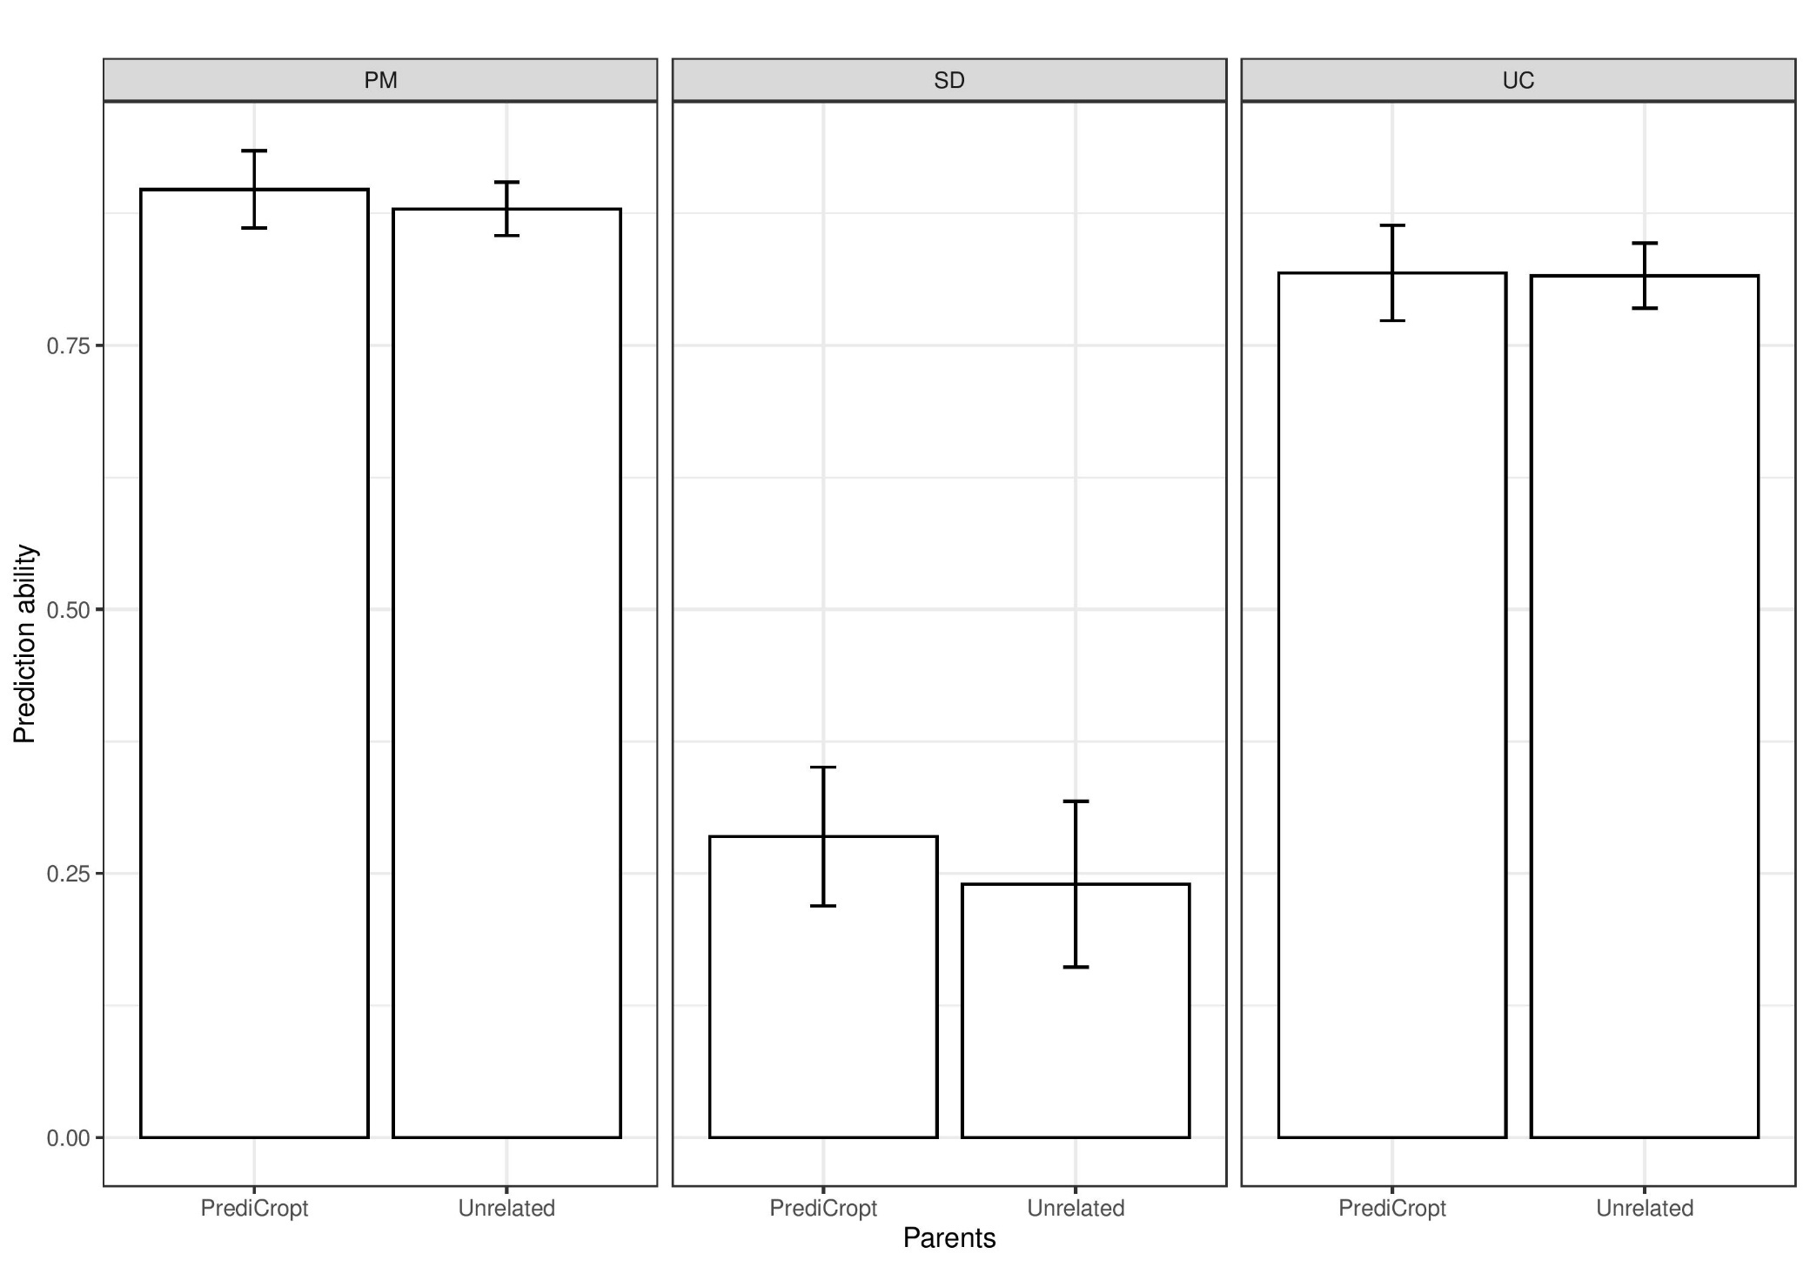
Results: predictive ability and genetic constitution of parents
Number of progenies per cross as in experimental data
Heritability = 0.7
Number of QTL = 300
Marker effects estimated with BayesA
simulations
p. 17

Slide 65
Results: predictive ability and genetic constitution of parents
Number of progenies per cross as in experimental data
Heritability = 0.7
Number of QTL = 300
Marker effects estimated with BayesA
simulations
p. 17

